Slide 1
Road Safety
SSATP CONTRIBUTION
SSATP Annual Meeting Dec 11-12, 2012 Addis Ababa
Justin Runji jrunji@worldbank.org
SSATP – ssatp@worldbank.org

Slide 2
Content
Africa Road Safety – What are the fundamental issues?
Are there success areas to build upon?
There are many players - Can SSATP make a difference?
What is SSATP doing differently?
How would countries benefit?
What impact on UN and Africa Decade of Action Plan?

Slide 3
Three fundamental issues

Slide 4
1. RS situation is .. disheartening
Basic Accident Prediction Model
Number of Accidents = F(Traffic Volume, Road Length, Other Risks)
But
SSA has the lowest motor vehicle population in the world at 2% *
SSA has the lowest road density in the world at 0.08 km /sq. km*
Total road accident deaths Africa stands at 9% of world total*
SSA has highest fatality per capita at 32.2 deaths per 100,000 people**
Sources: *IRF World Road Statistics 2012 & **WHO Global Status Report 2009

Slide 6
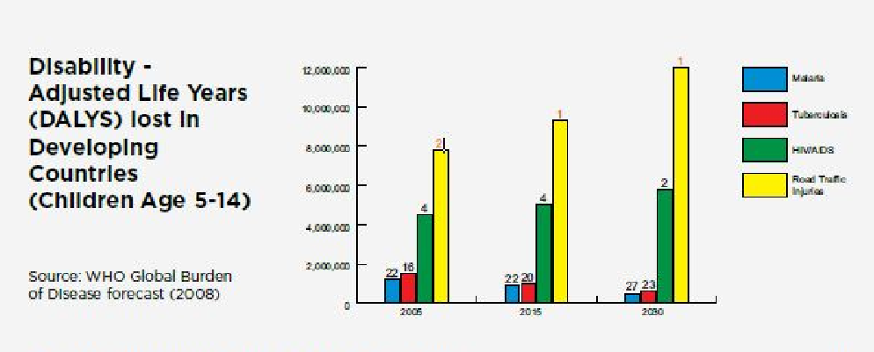

Slide 7
2. Negative developmental spin-offs
Expansion in traffic volume
Africa’s own success with sustained average GDP growth
Average vehicle operating speeds will increase
Overall road pavements are improving in Africa
Emphasis on road infrastructure rehabilitation and maintenance
Stable road funding through road user charges
Road transportation dominance projected to continue
Close to 90% of passenger and freight traffic – higher than in other continents
Dangerous mix in traffic on the roads
Goods and passenger traffic
Long and short haul traffic
Motorized and non-motorized

Slide 8
3. RS management is not robust
Only a few countries have truly addressed the First Pillar on Road Safety Management
Without a robust First Pillar, The other Four Pillars are difficult to achieve
Road Safety data is still not well managed … so Africa cannot bench mark or assess progress with precision
Support wings are weak - enforcement, regulatory, education,
Other underlying factors - funding, mandate, political profile

Slide 9
Are there success areas to build upon?

Slide 10
1. Results of good collaboration
SSATP, GRSP, RTSA, WB - Lusaka “Cities Conference” in Lusaka Oct. 2012
Focus on pedestrian safety
SSATP, WHO, UNECA, AU – Data and UN Decade Pillars Conference in Addis Ababa Nov. 2012
Focus on better reporting and Pillar I

Slide 11
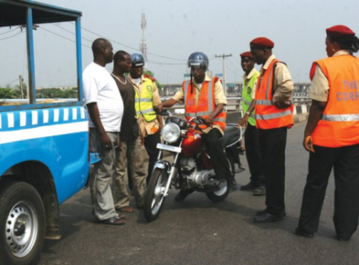
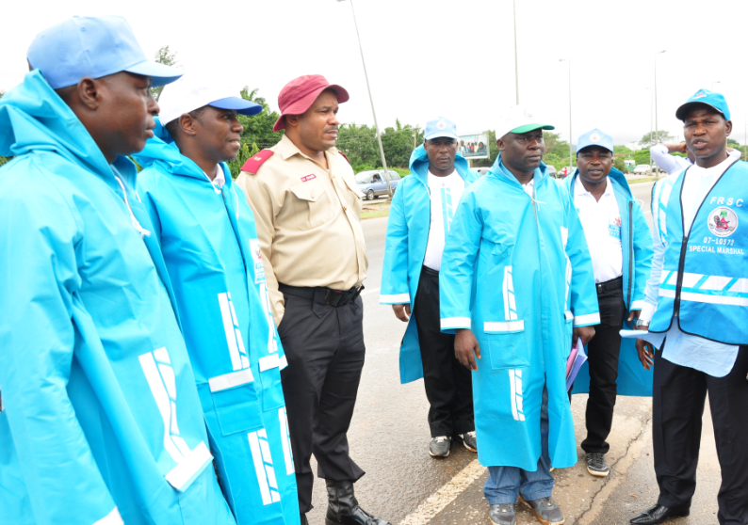
2. Sharing good practice
Nigeria’s Federal Road Safety Corps
18,000 Regular Marshals
18,000 Special Marshals (voluntary)
Youth Clubs (voluntary)

Slide 12
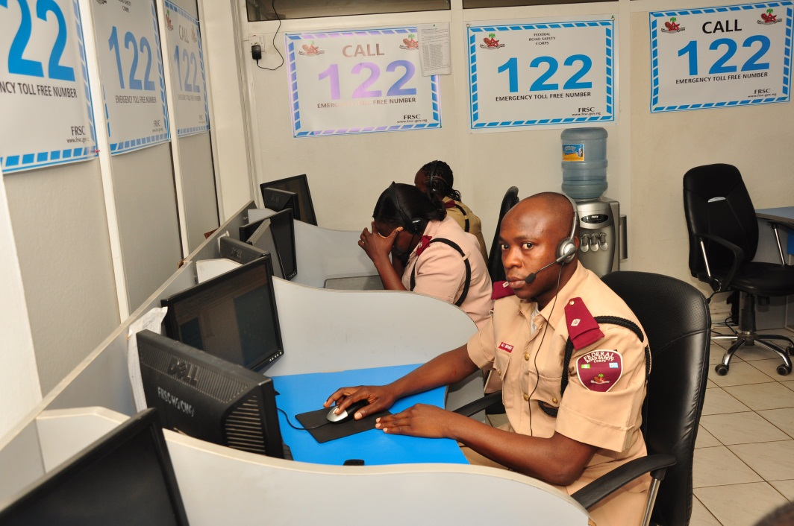
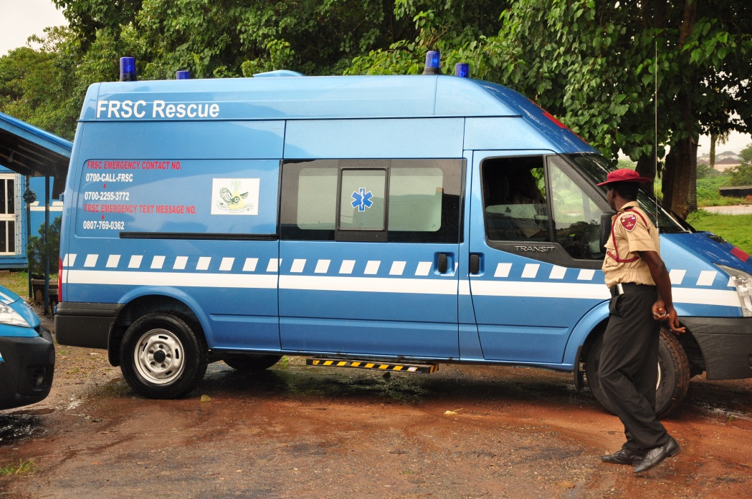
2. Sharing good practice…
Toll-free emergency number
Call center open 24/7
Free assistance 24/7
Roadside clinics supplement existing emergency wards

Slide 13
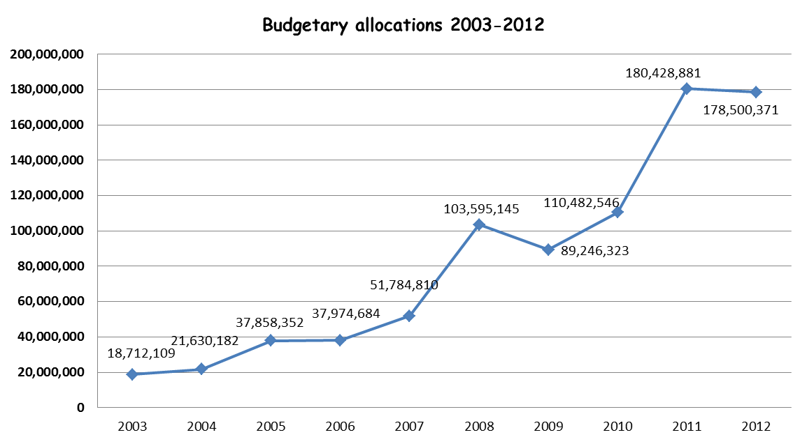
3. Good practice – Better resourced RS
Note the tenfold funding increase

Slide 14
4. Emerging initiatives
Funding frameworks for RS
Capacity enhancement in Enforcement
Mainstreaming RS in ODA projects
Focus on Pedestrian Safety
Institutionalization of Road Safety audit
Promotion of high impact interventions

Slide 15
SSATP can make a difference?

Slide 16
1. In policy, capacity & coordination
SSATP has only two mandates – offering potential for focus and clarity
Transport Policy Development
Capacity Development
A need for a continent-wide coordination has already been expressed
Ref. 2nd African Road Safety Conference Nov. 9-11, 2011
SSATP has demonstrated its “Change Agent” potential
RMI
Rural mobility

Slide 17
2. SSATP has a RS strategy
To partner with other development partners (WB’s AFTTR, HD, GRSF; GRSP, UNECA, WHO, and Corporates eg. TOTAL)
To work with REC’s, Regional Corridor Groups, Countries, and Cities.
To support UN Decade of Action and Africa Plan of Action by working with selected countries at country level address
Policy and strategy development, capacity building and promotion of high impact interventions

Slide 18
4. Outside opinion
“Despite recent challenges, SSATP continues to be a strategically well placed, respected and potentially powerful programme through which to influence national and regional transport policy in Africa”
Independent Review Opinion

Slide 19
What is SSATP doing differently?

Slide 20
Working with countries
KEY Objectives
Strengthen Policy Formulation
Strengthening of Road Safety Lead Agencies
Strengthening of Road Safety Strategies
Promote implementation of High-Impact Interventions

Slide 21
Ethiopia
National Road Safety Council
Capacity review of the NRSC and suggestions for strengthening
Facilitate strengthening and resource mobilization for NRSC
Ethiopia Road Authority
Institutionalization of road safety audit and integration of safety in design
Procedure for integration of road safety in transport projects
Development of design standards for road safety measures
Federal Traffic Police
Facilitate training for police
Prepare enforcement pilot project
Ethiopia Road Fund
Framework and criteria for allocation of funding for road safety.

Slide 22
Zambia
Road Transport and Safety Agency
Cross-cutting Safe Road Section Project Lusaka – Kabwe
Capacity review of RTSA.
University Teaching Hospital
Support to Post-crash Care
City of Lusaka
Planning and interventions for pedestrian safety
Collaboration with corporates
Traffic Police
Training, PC’s and equipment for field control.
Coordination of data and reporting with health sector.
Road Development Agency
Safe Corridor Project (see RTSA) to include road safety audits and safety measures.

Slide 23
Cameroon
Road Safety Department (in MoT)
Road Safety Management Capacity Review and prioritization of steps to strengthen lead agency capacity and national action plan.
Assistance to build capacity for RSD and other main stakeholders
Assistance for National Road Safety Strategy/ Action Plan

Slide 24
Abidjan-Lagos Corridor
Consultations with Corridor countries through lead agencies to identify major stakeholders and issues along the corridor
Collaboration with ALCO for coordination of activities across borders
Contact country corridor committees to address road safety in cooperation with lead agencies
A detailed study is underway, to be completed in March 2013

Slide 25
Central Corridor (East Africa)
Focus on road safety practices by commercial freight transport companies on the Central Corridor (on the section Tanzania / Rwanda / Burundi)
Active involvement of road transport companies (management and drivers) and regulatory authorities to apply best industry practices and improve driver preparedness and qualification
Identification of challenges linked to switching driving sides along the corridor route
Implementation through capacity building for the Central Corridor authority (CCTTFA)

Slide 26
How will countries benefit

Slide 27
“There is strength in numbers”
Policy and strategy formulation and/or review
Capacity building of agencies and around Pillars
Knowledge creation and sharing
Share and/or replicate good practices
Peer pressure and peer reviews

Slide 28
Impact on UN and Africa Decade of Action Plan

Slide 29
From the Addis Conference
Recommendation: SSATP to support and facilitate the attainment of the UN Decade of Action for road safety and the implementation of the Africa Plan of Action by:
Facilitating the formulation of RS strategies at country level
Facilitating creation of strong lead agencies
Facilitating the formation of regional associations of lead agencies
Assist (with AU) in raising political profile and convening powers of lead agencies
Promote better funding for RS

Slide 30
Thank you
Justin Runji jrunji@worldbank.org
SSATP – ssatp@worldbank.org

