Slide 1

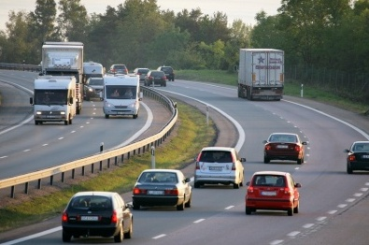
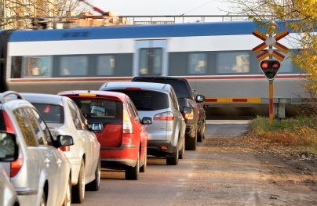

Use of data for intervention design: Sweden experience
Matts-Åke Belin PhD
Adj. Professor Royal Institute of Technology (KTH)
Swedish Transport Administration
Vision Zero Academy matts-ake.belin@trafikverket.se

Slide 2
Common Sense………
is not a good base for road safety interventions

Slide 3
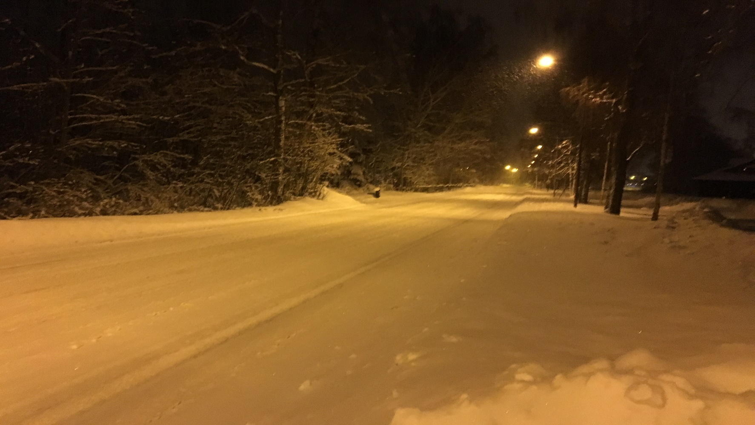

Slide 4
Skid Avoidance Training
Accidents
Ordinary Drivers +12
Emergency Drivers +45

Slide 5
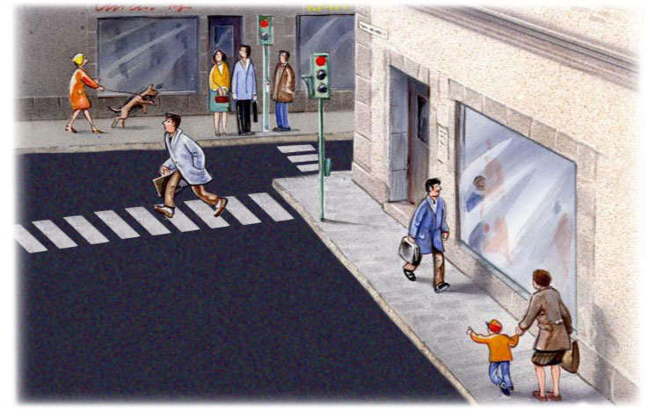

Slide 6
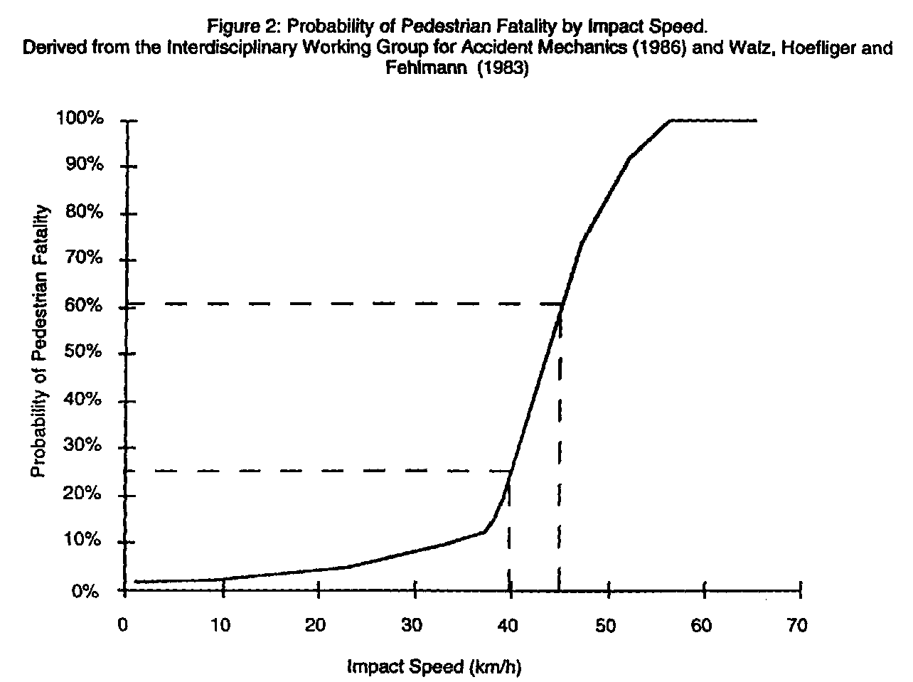
Probability of Pedestrian Fatality by Impact Speed

Slide 7
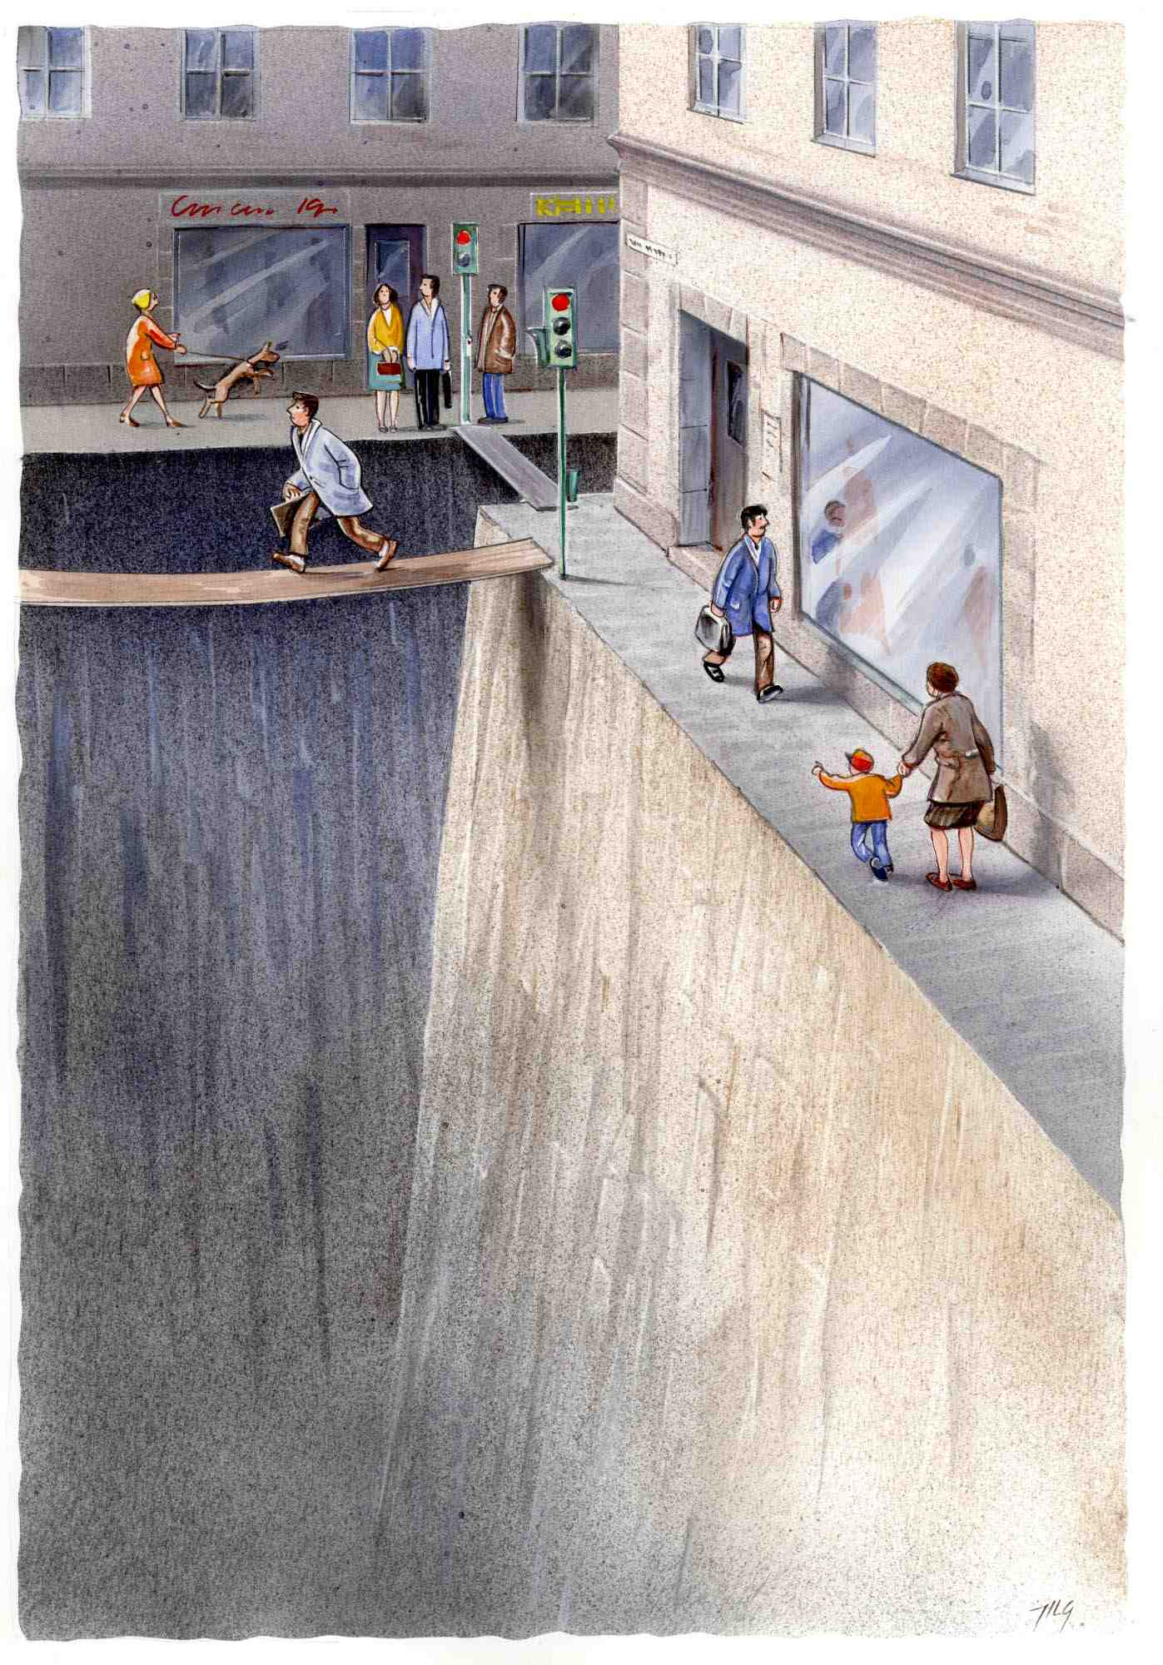

Slide 8
Policy
Policy
Data
Intervention

Slide 9
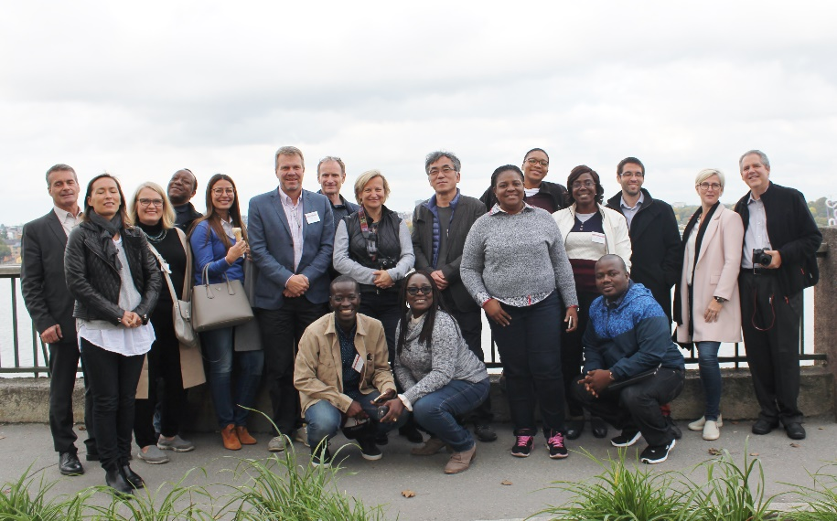
http://www.trafikverksskolan.se/visionzero
Next event 2018-09-23--2018-09-28

Slide 10

Traditional vs Vision Zero

Slide 12
Traditional vs Vision Zero
Individual
behavior
System
resilience

Slide 13
Share of the Swedish car fleet with highest safety standard according to Euro NCAP

Slide 14
Share of traffic on roads with speed limit over 80 km/h with middle barrier

