Slide 1
KENYA’S EXPECTATION OF ROAD SAFETY OBSERVATORY
TOWARDS THE ESTABLISHMENT OF ROAD SAFETY OBSERVATORY IN KENYA
20TH FEBRUARY, 2018
DR DUNCAN KIBOGONG

Slide 2
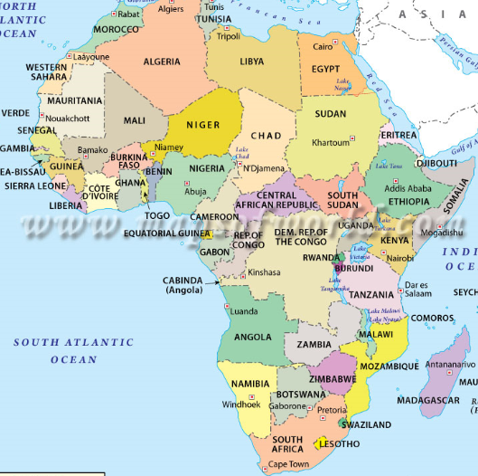
Africa
KENYA

Slide 3
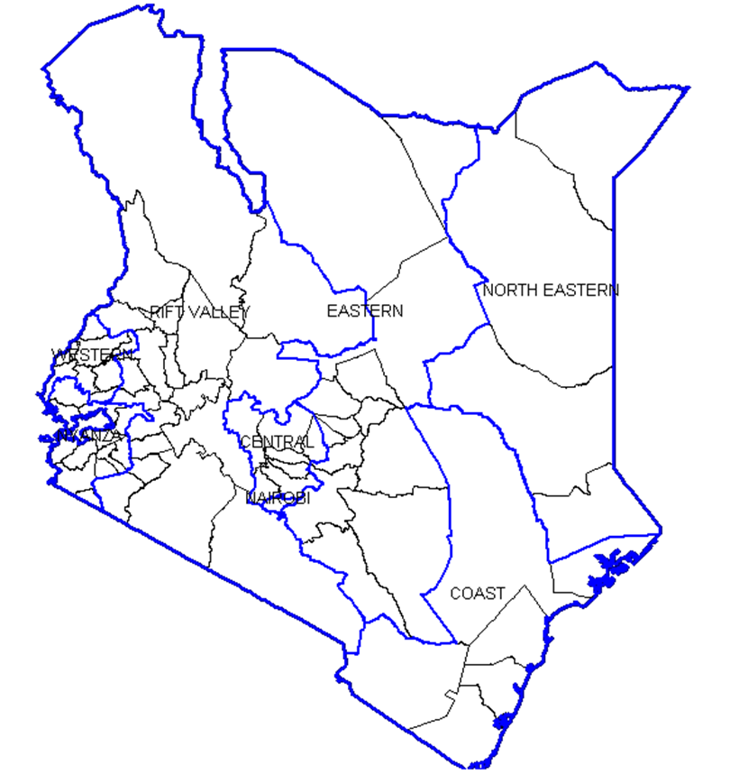
Kenya
South Sudan
Ethiopia
Uganda
Somalia
Tanzania
Indian Ocean

Slide 4
Kenya…
East African Country
2015 Population of 47.8*
Surface area:582,650 km²
Number of registered vehicles (2016): 2,758,731^{b}
* Kenya National Bureau of Statistics Projections/World Bank Report
^{b}National Transport and Safety Authority (NTSA)

Slide 5
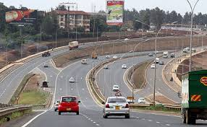
VISION & MISSION
Vision
Efficient, Reliable and Safe Road Transport System in Kenya
Mission
To continually improve accessibility and safety of Kenya’s road transport system for all users

Slide 6

OUR MANDATE
To advise and make recommendations on matters relating to road transport and safety
To Implement policies relating to road transport and safety
To plan, manage and regulate the road transport sector in accordance with the provisions of the NTSA Act no.33, 2012
To ensure the provision of safe, reliable and efficient road transport service

Slide 7
NTSA functions
In performance of its functions, the Authority is mandated to:-
  register and license motor vehicles,
  conduct motor vehicle inspection and certification,
  regulate public service vehicles,
  advise the Government on national policy with regard to road transport sector,
  develop and implement road safety strategies,
  facilitate the education of members of the public on road safety,
  conduct research and audits on road safety,
  compile inspection reports relating to traffic accidents,
  establish systems and procedures for, and oversee the training, testing and licensing of drivers,
  formulate and review the curriculum of driving schools, and
  Coordinate the activities of persons and organizations dealing in matters relating to road safety.
  Perform such other functions as may be conferred on it by the Cabinet Secretary or by any other written Law

Slide 8
NTSA
The Sessional Paper Number 2 of 2012 on Integrated National Transport Policy identified disjointed and weak institutional framework as one of the challenges experienced in management of the road transport subsector in Kenya
This disjointedness contributed to unsafe, unreliable and inefficient road transport systems in Kenya
The UN Decade of Global Action plan in pillar 1( Road Safety Management) recommend the setting up of a lead agency

Slide 9
Road crash data systems
Introduction
NTSA’s Action Plan 2015-2020 is developed with this consideration in the thematic areas of:
Road Crash Data System whose objective is ‘’To establish, support and implement road safety data systems that supports generation of evidence based policy formulation and implementation and for robust monitoring and evaluation of the action plan’’
Road Safety Research whose objective is ‘’ To regularly conduct research on road safety issues, analyze data and input into decision making processes to make effective and appropriate road safety interventions

Slide 10
DATA IMPROVEMENT SINCE NTSA INCEPTION
There’s general improvement of data since NTSA inceptions
Initially road safety statistics were just about an absolute figure and other parameters were not being measured
Currently data is analyzed to inform decision making to a larger extend compared to what was existing before
More refined data has enable NTSA to have data led road safety interventions with some commendable level of success
But there is a lot to be improved to generate more refined data for evidence based road safety policies and interventions

Slide 11
Better Data by in Kenya NTSA inception
Detailed road crash data is available on:
  The road user type involved in rash
  The vehicle type
  Distribution across the time of the day
  Distribution across the week
  Distribution across the year
  Distribution across the counties
  Distribution across age groups
  Distribution on Gender/sex
  The roads crashes happen esp in the
  The causes of crashes-through cause codes

Slide 12
KENYA STRENGTH ON TIMS
NTSA has established the Transport Integrated Management Systems (TIMS), which serves as the central database and platform for managing driver licensing, motor vehicle inspections, vehicle registration and PSV management in Kenya.
Transport Integrated Managements Systems (TIMS) to enhance efficiency and increased reliability of data
The TIMS helps in the management of the following information:
  Vehicle registration data
  Motor vehicle inspection data
  Statistics on traffic violations
  Road service licences for public transport
  Driving license data
This provide exposure data

Slide 13
TIMS…
Some Online-Services in the TIMS platform
  Motor Vehicle Registration and Licencing(Transfers, duplicate logbooks)
  Motor Vehicle Inspection Self-booking
  Application of Provisional Driving License
  Booking for a Driving Test
  Interim Drivers License
  Duplicate Driving License
  Endorsement of additional Classes
  Renewal of Drivers License (1 yr and 3yrs)
  Amendment of Drivers License Details
  Drivers PSV license
  Conductors PSV license
  Road Service License
  Mobile policing Device/Gadget
  Verification of genuine NTSA documents using SMS code

Slide 14
Data Sources in Kenya
Data is available in the following
  Police,
  Health Institution
  Vital registration Department
  Insurance companies,
  Insurance regulatory Authority,
  Ambulance Records
  NTSA
  Research Institutions/universities,
  Private Road Transport Companies
Most of the data available for use currently is from the traffic department.

Slide 15
POLICE DATA
The police data, which is the main source, has the following attributes:
STRENGTHS:
It is national in terms of coverage
Collect most of the important data elements
Available on daily basis
Raw data and can be analyzed in whichever format you want
WEAKNESSES
Most of the information derived from this data source is fatal injuries
There is no electronic linkages with the other data sources
The data is provided in raw absolute formats and not in tabulated or other customized specifications
Demonstrates a weak link to other systems for follow up of injuries
Definitions on the severity of injury by the police is not standardizes as per the international standard. In any case Kenyan police aren’t trained to differentiate the same.

Slide 16
VITAL STATISTICS
Vital Statistics is a data source in Kenya
  coverage –currently standing at 50%
  Completeness –
  Missing data on death certificates;
  Misclassification of cause of death – doctors must be sufficiently trained to record and code correctly the underlying cause of death;
  Inadequate coding –
  NTSA together with the registration of deaths department is working to regularly get this data and further link the two institutions

Slide 17
Health facility data…
Health facility data advantage is it picks on the burden and severity of RTIs
Some challenges on this include:
People with minor injuries not seeking formal medical care;
Poor access to health facilities;
Injuries treated at private hospitals remaining unrecorded, as non-government
Lack of training, expertise, interest or time on the part of health workers, who may not record all relevant details of the injury;
Data being incorrectly coded by the health worker, or by the person responsible for data extraction or data entry.

Slide 18
Exposure Data…
EXPOSURE DATA AVAILABLE
The TIMS helps in the management of the following information:
  Vehicle registration data
  Motor vehicle inspection data
  Statistics on traffic violations
  Road service licences for public transport
  Driving license data
Road layout, design and environment;
  Available with the road Authorities
The demographics of the county/county
  This information is available from secondary sources-National Census, KNBS, KDHS
  EXPOSURE DATA WEAKNESS
Traffic flows and characteristics/traffic volume data
  May require a study or Intelligent Transport Systems/ITS which will pick the information real-time.

Slide 19
Cooperation and Collaboration
Kenya is cooperates with a number of African Countries through a number of regional integrations.
Some of these blocks on standardization of road transport and road safety protocols – including Motor vehicle inspections, driving School Curriculums among other road transport and safety themes
These include;
  East African Community-Kenya, Uganda, Tanzania, South Sudan, Rwanda, Burudi
  Northern Corridor Integration Projects-Kenya, Uganda, Rwanda,South Sudan ,DRC
  IGAD-
  AU Commission
African Road Safety Observatory can be leveraged on this regional integration

Slide 20
Expectation
The observatory be set
Standardization of Minimum data elements to be collected (road related ,crash related, vehicle related and person/road user related)
The data sources as a minimum include data from the police, health and Vital statistics
Fatal and Injury severity data be collected
Definition of a fatal injury be standardized
Definition of injury be standardized
Exposure data to be collected form the participating countries be standardized
Safety performance Indicators be standardized across countries

Slide 21
Expectation…
That the data be analyzed as soon as collected
The data is analyzed and standard template for reporting
Data be shared with each country fro approval before dissemination via the observatory’s portal
The participating countries to agree on the period need to seek approvals before dissemination of the analyzed data/report
The periodicity of the report be every 6 months
The participating countries to have annual meeting to discuss the data and issues appertaining to the observatory.
Efforts be made towards measuring the costs of crashes as capacities improve
That the observatory becomes an avenue of information sharing of best practice etc

Slide 22
Main Actors of the Observatory
State Agencies and Institutions:
  Ministry of Transport and Infrastructure
  Mistry of Health
  National Transport and Safety Authority
  The Traffic Police
  Department of Civil Registration
  Kenya national Bureau of Statistics
  Road Authorities
  Insurance Regulatory Authority
  Universities and Research Institutions

Slide 23
Main Actors of the Observatory
International Actors;
  World Bank
  SSATP
  African Development Bank
  European Union
  WHO
  UN agencies
  UNON
  Regional Integration Blocs

Slide 24
Thank you

