Slide 1




SSATP ANNUAL MEETING 2010
Kampala, UGANDA
OCTOBER 18-21, 2010
Sub-Saharan Africa Transport Policy Program
TRANSPORT STRATEGY UPDATING PROCESS IN BURKINA FASO

Slide 2
OUTLINE OF PRESENTATION
1. Some historical benchmarks
2. Objectives sought by updating the transport strategy
3. Methodological approach and implementation process
4. Ongoing formulation of the new strategy and donor roundtable

Slide 3
1. SOME HISTORICAL BENCHMARKS
1997-2000
Preparation of the Ten-Year Transport Development Strategy (SDDT)
2000
Adoption of the Poverty Reduction Strategy Paper (PRSP) and the Ten-Year Transport Development Strategy, with both strategies adopted independently of one another
Aug 2006 to end-Mar 2007
Conduct of the process for comparative analysis of the transport and poverty reduction strategies
Development by the SSATP of a methodology for comparative analysis of the transport strategy and poverty reduction strategies (PRSs)
End-2002
2003
Development and adoption of the national rural transport strategy (SNTR), supplementing the Ten-Year Transport Development Strategy, in order better to take account of the problems associated with the mobility of rural populations and their access to essential basic services
Early 2010
Startup of the process of updating the transport strategy and preparation of the Strategy for Accelerated Growth and Sustainable Development of Burkina Faso to succeed the PRSP beginning in 2011

Slide 4
2. OBJECTIVES SOUGHT BY UPDATING THE TRANSPORT STRATEGY
2.1-Overall objectives
Overall objectives
Develop the strategy consistently with existing strategies: ENP 2025, SCADD, SNAT, laws on decentralization and land transport, MDGs, etc.
Provide Burkina Faso, for the 2010-2025 period, with a single reference base for the development of the transport sector
Incorporate emerging thematic areas (gender, employment, environmental protection, security and safety, and monitoring and evaluation

Slide 5
2. OBJECTIVES SOUGHT BY UPDATING THE TRANSPORT STRATEGY
2.2-Specific objectives
Specific objectives
Update the Transport Sector Development Strategy and recast the SNTR
Prepare the Five-Year Priority Investment Program
Define a monitoring and evaluation system

Slide 6
3. METHODOLOGICAL APPROACH AND IMPLEMENTATION PROCESS
3.1-Methodological approach
A participatory approach, based on SSATP directives:
1- Introduction of a Stakeholder Group (GPP) including all actors in and beneficiaries of the transport sector.
2- Guidance for Stakeholders to ensure greater ownership of the process: a factor critical to achieving the results sought.
3- Comparative analysis of the poverty reduction and transport strategies.
4- Proposal for better taking the transport dimension into account in the poverty reduction and transport strategies.

Slide 7
3. METHODOLOGICAL APPROACH AND IMPLEMENTATION PROCESS
3.2-Implementation process
3-Conduct of the study and the validation process.
2-Drafting of terms of reference for selecting the consultant and conducting the updating study
1-Analysis of transport and poverty reduction strategies

Slide 8
3. METHODOLOGICAL APPROACH AND IMPLEMENTATION PROCESS
3.2-Implementation process
STAGE 1: ANALYSIS OF STRATEGIES (PTSR)
Preparatory phase
Analysis Process
(three workshops)
=>Efforts to line up government support of the principle
=>Creation of Steering Committee and training of its members
=>Establishment of Stakeholder Groups
=>Recruitment of facilitator
=>Preparation and scheduling of workshops
Workshop 1: Analysis of Poverty Reduction Strategy Paper (PRSP) (December 21 and 22, 2006)
Workshop 2: Analysis of transport and poverty reduction policies and strategies (January 16, 17, and 18, 2007)
Workshop 3: Analysis of policy and strategy preparation modalities (March 29, 30, and 31, 2007)
Formulation of recommendations and drafting of action plan for submission to the government

Slide 9
3. METHODOLOGICAL APPROACH AND IMPLEMENTATION PROCESS
3.2-Implementation process
STAGE 2: DRAFTING OF TORs and RECRUITMENT OF CONSULTANT
*Drafting of TORs on the basis of the conclusions and recommendations of the PTSR;
*Taking account of institutional changes, new strategies and policies: Burkina Faso ENP 2025, SNAT (2009), Framework law on transport, MDGs, cross-cutting issues (environment, gender, transport safety and security, employment, HIV/AIDS, etc.);
*Interconnection with the SCADD;
*Validation by the SSATP;
*Validation by stakeholders and TFPs;
*Selection and hiring of Consultant.

Slide 10
3. METHODOLOGICAL APPROACH AND IMPLEMENTATION PROCESS
3.2-Implementation process
STAGE 3: CONDUCT OF STUDY AND VALIDATION PROCESS
CONDUCT OF STUDY: Three (3) major stages
Stage 1: Diagnostic stock-taking of current strategy: status report, exhaustive assessment of implementation of ten-year strategy (2000-2010) by subsector in terms of sectoral reforms and investments, and definition of proposals for new strategic objectives
Stage 2: Formulation of the new transport sector development strategy in keeping with the SNAT, the SCADD, the MDGs, the Framework Law on Decentralization, the framework law on land transport, the effort to combat highway overloading, the facilitation of trade, and the cross-cutting issues.
Stage 3: - Proposal of Action Plans consistent with implementation of the new strategy, by strategic focus and objective,
- Proposal for a monitoring and evaluation system, with definition of the reference values of indicators.

Slide 11
3. METHODOLOGICAL APPROACH AND IMPLEMENTATION PROCESS
VALIDATION PROCESS: 3 levels of validation
The Technical Monitoring Committee (CTS), established by joint ministerial order
The Steering Committee (CP), established by joint ministerial order
The regional and national workshops
The CTS and the CP have been established by the Government by means of joint orders of the two ministers responsible for the transport sector (MID and MT)

Slide 12
3. METHODOLOGICAL APPROACH AND IMPLEMENTATION PROCESS
Functions and Composition of the validation mechanisms
Technical Monitoring Committee
Steering Committee
FUNCTIONS
Regional and national workshops
FUNCTIONS
Monitoring the work of the consultant,
Providing secretariat services for the process as a whole,
Producing reports on its views for the CP.
FUNCTIONS
COMPOSITION
6 members from the Transport and Finance Administrations
Coordinating and supervising the various phases of the study,
Validating the reports produced by the Consultant.
COMPOSITION
42 members from public administrations, the private sector, civil society, and socio-professional organizations
Validation of the various reports from different stages of the study.
COMPOSITION
300 participants from the Governorships, deconcentrated administrations, civil society, socio-professional organizations, NGOs, and associations.

Slide 13
4. FORMULATION OF THE NEW STRATEGY AND DONOR ROUNDTABLE
Status report on process
Validation of the Stage 1 report: stock-taking on the strategy
Submission of draft Stage 2 report scheduled for early October 2010
Submission of draft Stage 3 report scheduled for mid-November 2010
Donor roundtable: mid-December 2010

Slide 14

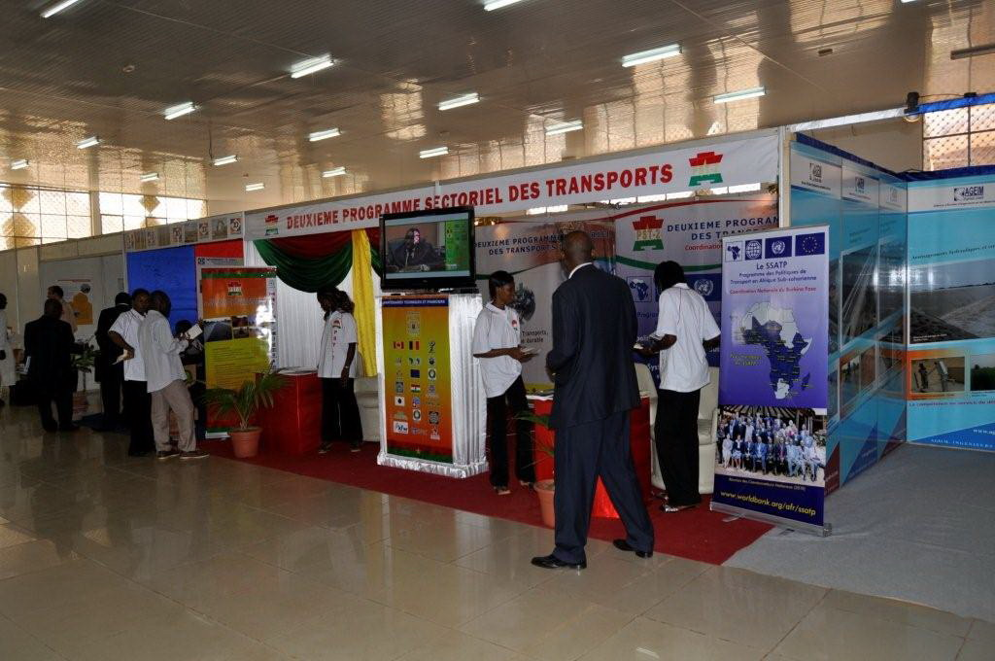
Thank you for your kind attention

