Slide 1
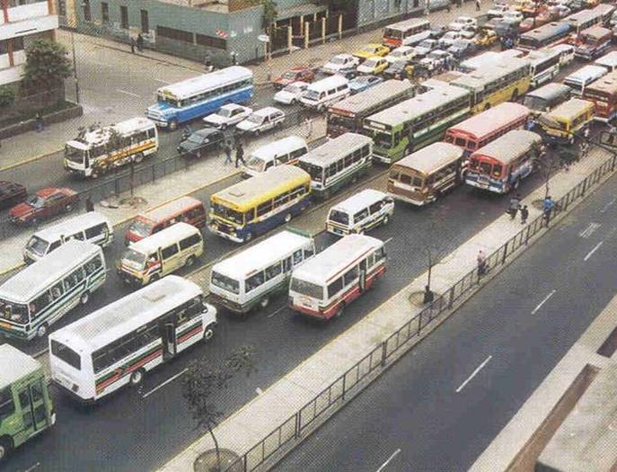
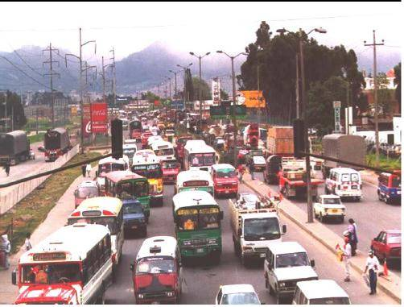
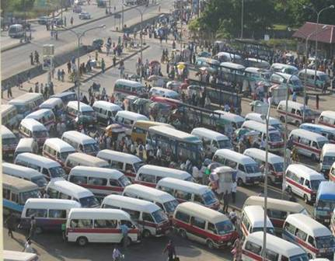
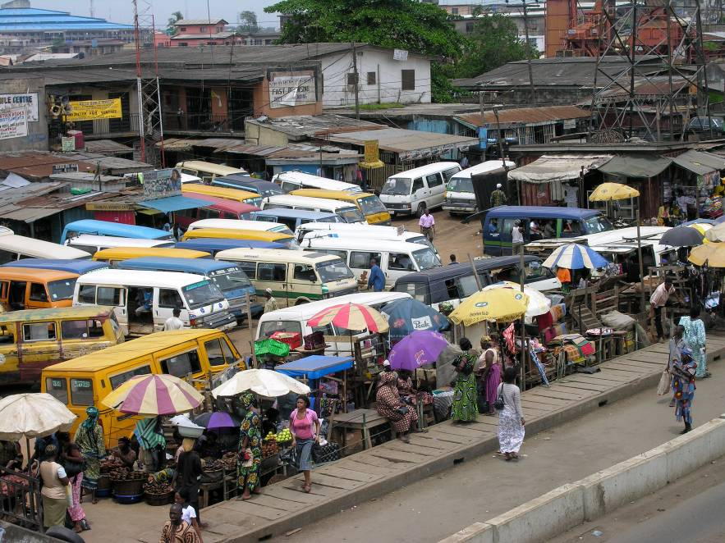
Lima
Bogota (Before)
Urban Transport: Looking Forward
Ajay Kumar
Lagos
Dar es Salaam

Slide 2
Far-Reaching Impacts of Transport
Transport effects almost every aspect of life in cities
  Economic, land development
  Environmental quality, local and global
  Health
  Social equity
Addressing urban transport problems requires an understanding of a complex set of factors

Slide 3
Economic
Financial
Political
Land Use
Communications
Urban
Transport
Travel Market
Technical
Geographic
Environment
Travel
Options
Urban
Design
Social

Slide 4
Urban Transport Concerns
Congestion
Mobility and access
Sustainability
  Health (Safety, Air Quality)
  Land Use
  Energy
  Climate change
  Economic/social development
  Existing system

Slide 5
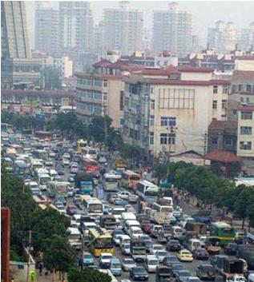
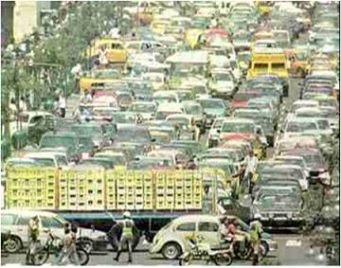
Symptom: Traffic Congestion

Slide 6
Possible Cause of Congestion
Land Use
Poor land use, site planning
  Decentralization
  Widely scattered, single-purpose developments
  Site planning not pedestrian or public transport “friendly”
  Site planning forces auto dependency

Slide 7
Changes in Land Use
Accra—in the past decade, population doubled & city area tripled—reducing density from 14,000 to 8,000 persons per sq km
Abidjan—city population has doubled every 7 yrs since 1945 upto early 90s
Dakar—many new satellite towns are located >30km from city center
Lagos—grown beyond State boundary into adjoining state of Ogun
In all cities, two-third of the jobs are located in city center
RESULT—commuting times have increased to over one hour each way (over 2 hours in some cities)

Slide 8
Possible Cause of Congestion
Demand Side Changes
Explosive population, income and motorization growth
  By 2025, >50% urban population
  By 2025, >50% increase in motorized transport
  Exponential growth in motorcycle
Changing demographics
  Declining household sizes (grown children moving to own residences)
  Younger/older population
Changing origin-to-destination patterns
  More destinations outside City Center

Slide 9
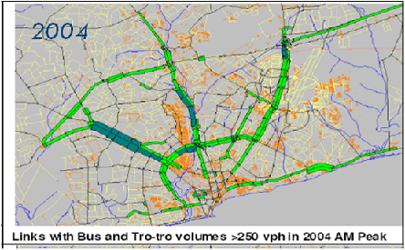
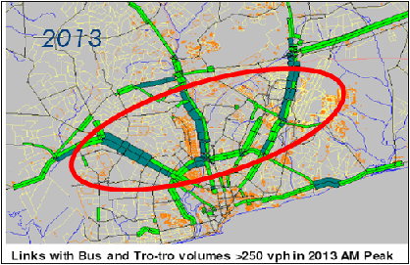
Travel
Over Time
Accra, Ghana
Where the Growth is

Slide 10
Possible Cause of Congestion
Supply Side Changes
Non-Motorized Transport
  Declining space dedicated
  Right-of-Way (ROW) encroachment
Public transport system
  On-street, poorly regulated competition
  Route structure does not match travel needs
  Insufficient capacity in major corridors
Roads
  Poor design/condition /connectivity
      Average road density in SSA cities is 300m/1000 population
  Ineffective parking /traffic management
  Poor enforcement of traffic rules

Slide 11
Lessons from Past
Multiple institutions involved with planning, regulation, licensing, resource allocation and enforcement
Lack of coordinated land use-transport planning
Inadequate environmental and social impact assessment
Deterioration in coverage and quality of organized public transport services
  Proliferation of unregulated private sector operators (minibuses/taxis/motor cycles)

Slide 12
Lessons from Past
Importance of infrastructure
  Poor quality roads & lack of capacity reduce productivity of urban transport fleets
  Funding needs to be increased to reflect importance of urban transport in national system
Existing regulation should be enforced
  Control parking
  Vehicle inspections

Slide 13
Lessons from Past
Monitoring system performance
  Basic statistics not collected and reported in an organized way
  As a result, difficult to monitor changes and develop solutions

Slide 14
Strategic Planning for Urban Transport: Why?
Transport problems growing in magnitude and complexity
Related to other strategic issues
Transport too often implemented and operated in pieces defined by mode and geography; too little decision support information relating to entire metropolitan multi-modal system
Focus on pre conceived solutions, not an understanding of problems and issues

Slide 15
Starting Point? A Vision
A vision of the metropolis in the future (20+ years) including transport and related sectors
Projects may be outputs, not inputs, if not already committed
“Vision: Two line, 40 km Metro, 5 km monorail and three ring roads by 2020”

Slide 16
Planning Process
All decisions are “political” irrespective of political system, but in developing countries, decision makers are often uninformed
  No objective, competent decision support information for investments
  Lack of transparency

Slide 17
Metropolitan Vision: What Should the Metropolitan Area Look Like in 20 Years?
Vision covers transport and related quality of life issues
Transport perspective goes beyond congestion considerations:
  Safety
  Mobility as well as Access
  Environment
Vision must be realistic and reasonably consistent with financial and other potential resources

Slide 18
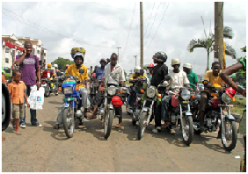
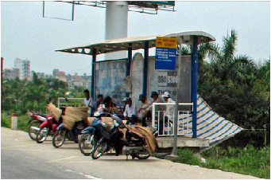
Emerging Trend: Growth in Motorcycles

Slide 19
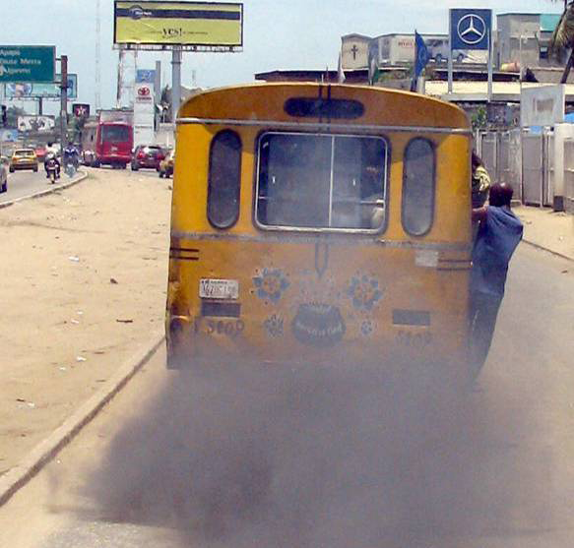
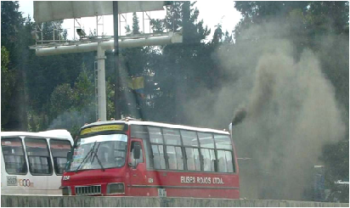
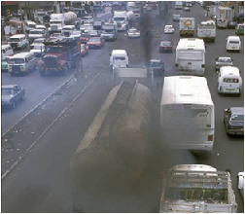
Declining local environment

Slide 20
Factors influencing growth of motorcycles
+ ve |  | -ve | Push | Pull
Demand | Supply
Time savings Door-to-door service Improve mobility Easy access Demand responsive Easy maneuverability Employment generation | Easy availability Limited street space Multipurpose Transport freight and passenger | Congestion Pollution Accidents Safety/crime unregulated | Urban sprawl Rising inc. poor secondary road network poor road quality Low density Uncontrolled growth Absence of safe, secure, affordable alternatives | Inexpensive Declining costs Easy credit High unem-ployment Low car ownership unregulated

Slide 21
The Way Forward
Infrastructure
  Increase funding for maintenance
  Rehabilitate existing roads
  Small-scale capacity expansion
  Provide exclusive bus lanes (BRT “systems”)
Traffic Management
  Enforce existing regulations on parking, etc.
  Junction design
  Bus priorities; junctions & bus lanes

Slide 22
The Way Forward
Develop capacity for public transport planning and regulation
Staged introduction of route structure & allocation / licensing
Route franchises can be allocated by agreement / negotiation with existing operators
Develop integrated land use-transport planning framework and appropriate pricing strategies

Slide 23
Effective Strategic Metropolitan
Transport Planning
Comprehensive
Continuous
Cooperative
Connected
Championed
Communicated

Slide 24
THANK YOU

