Slide 1

Railway Concessions in
Sub-Saharan Africa:
Lessons learned
The World Bank Group
Presented by: Emmanuel James,
Program Coordinator – Africa Transport
The World Bank

Slide 2
How much do we know?
A lot:
  First rail concession in Sub Saharan Africa (SSA) dates back to 1995 (Sitarail - links Abidjan to Ouagadougou)
  Since 1995, rail operations in SSA have been privatized using all sort of public private partnerships (PPPs) – from management contract (Sizarail), to hybrid rail concession contracts of the “affermage” type (Sitarail), to full blown concession contracts (TRC, RSZ, Camrail).
  Over the last 5 years, a large body of evidences regarding the performances , or lack thereof, of rail concessions in SSA has been published. The latest : “Off track: Railways in Sub Saharan Africa” published under the Africa Infrastructure series in 2009 provides ample details of the challenges facing rail operations in SSA and, de facto, rail concessions.
The scope of this presentation will only be on the lessons learned from general freight and passengers mix rail concessions, not dedicated mining rail concessions.

Slide 3
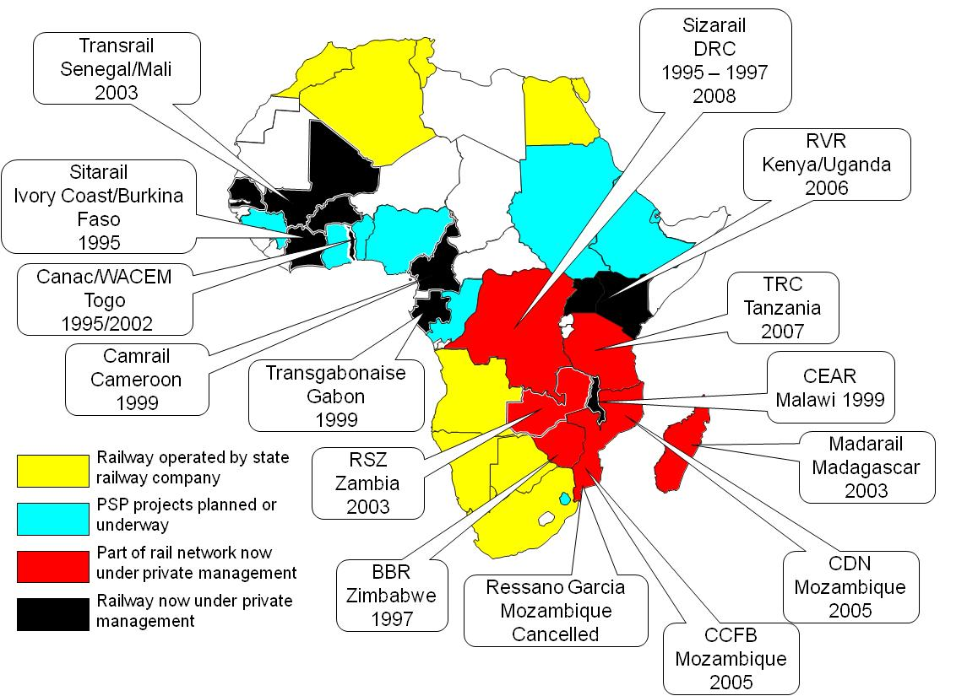
Railways concessions in SSA: when and where

Slide 4
What are the activity levels of railway concessions (2008/2009)?

Slide 5
What is the current performance of rail concessions in SSA?
 | Concession | Countries |  | Year of concessioning |  | Network length (km) |  | Total support in US$ millions |  | Current Performance ^{1/} |  |  | Investment responsibility
 |  |  |  |  |  |  |  | IDA | IFC | Operational |  | Financial | Infrastructure | Rolling Stock
 | Sitarail | Ivory Coast, Burkina Faso |  | 1995 |  | 1,245 |  | 21 | none | A |  | C | Public | Private
 | Camrail | Cameroon |  | 1999 |  | 1,104 |  | 113 | none | B |  | A | Public | Private
 | CEAR | Malawi |  | 2000 |  | 797 |  | 10 | none | D |  | D | Private | Private
 | RSZ | Zambia |  | 2002 |  | 1,273 |  | 35 | none | C |  | C | Private | Private
 | Madarail | Madagascar |  | 2003 |  | 681 |  | 65 | none | B |  | C | Public | Private
 | Transrail | Senegal, Mali |  | 2003 |  | 1,546 |  | 45 | none | C |  | D | Private | Private
 | CCFB (Beira) | Mozambique |  | 2005 |  | 725 |  | 110 | none | B |  | C | Private | Private
 | TransGabonais | Gabon |  | 2005 |  | 814 |  | 0 | none | B |  | C | Public | Private
 | Nacala | Mozambique |  | 2005 |  | 600 |  | 20 | none | C |  | D | Private | Private
 | KRC-URC | Kenya-Uganda |  | 2006 |  | 2,454 |  | 74 | 32 | C |  | D | Private | Private
 | TRC | Tanzania |  | 2007 |  | 2,722 |  | 35 | 44 | D |  | D | Private | Private
 | TOTAL |  |  |  |  |  |  | 528 | 76
 | 1/ Operational Performance provides a combined measure of rolling reliability, track incidents and quality and personnel productivity. A = best in class, B = Above average performance, C = Average performance and D = Below average performace.
 | 1/ Financial performance provides a combined measure of net cash flow generation capacity, net income level and level of indebtness.
 | A = strong positive cash flow and net income (> 5% of turnover) and sustainable debt load, B = Positive cash flow and net income (<5% of turnover) and average debt load, C = Positive cash flow (<5% of turnover), negative net income and higher than average debt load, and D = negative cash flow and net income and high debt load.
 |  | Change of responsibility from Private to Public during the course of concession contract implementation
 |  | Although investment is a private responsibility, most investment to date was financed by on lending of Donors' money from host governments to the Concessionaire

Slide 6
Weak performance: overestimation of serviceable freight markets
Traffic gains have been much lower than expected because: a) road haulers ability to adapt to renewed competition has been underestimated and, b) Host governments have failed to implement level playing field internmodal competition.
Pre-concession
Post concession
Total traffic in Tkm - Millions
CI Crisis

Slide 7
Weak performance: under estimation of investment needs
Investment plans for infrastructure rehabilitation have focused only on the first five years of the concession. They have ignored long term needs that have proven to be much larger than anticipated as both Governments and private operators, at the concession bidding stage, have downplayed the decrepit state of rail infrastructure.
 | 2009 Total revenues (US$ millions) | Investments needs (2008/2020) (US$ millions) |  | Total investment as a multiple of 2009 revenues
 |  | Infrastructure | Rolling Stock & related infrastructure
Camrail | 114 | 174 | 198 | 3.3
Sitarail | 66 | 132 | 99 | 3.5
Even assuming an annual high cash flow margin of 20% of net revenues, Camrail and Sitarail would need, respectively, 16 and 18 years to repay this investment using a no (zero) interest loan.

Slide 8
Weak performance: Undercapitalization of concessions
Concession companies started with a far too limited capital base, in part to lower the risk perception of private investors. A lot of concessions felt rapidly into a cash strapped situation as projected positive cash flows did not materialize.
Initial capital base
First five years planned investment
In US$ millions

Slide 9
Weak performance: undue passenger services expectations
Expectations related to passenger traffic led to misunderstandings between host Governments, concessionaires and the travelling public.
No rail passenger services operated by private operators since 1996 have ever been financial viable. They have all benefited either from indirect subsidies from freight operations or direct subsidies from Government’s treasuries.
Although subsidization of services does not constitute a problem per se, the political cost and risk associated by badly crafted subsidies scheme cannot be underestimated.
Weight of Passengers services and losses on Camrail’s financial bottom-line (2000-2008)

Slide 10
Weak performance: cross border railways management
Cross border management presents specific challenges:
  Accounting of transfer of infrastructure or rolling stock assets from one country to another;
  Dependence of landlocked countries from their neighbor’s investment – how do we lock the commitment of one country vis-à-vis the other?
  Synchronization of intermodal competition policies; and
  Synchronization of long haul passenger services and deficit payments.

Slide 11
How do we account for the overall disappointing performance of railway concessions – summary of findings
While they are many reasons that can account for the overall weak performance of railway concessions in SSA, four stand out:
  Overestimation of the serviceable freight markets;
  Underestimation of investment needs;
  Undercapitalization of concessions; and
  Undue expectations regarding passenger service.

Slide 12
Thank you
for your attention

