Slide 1
CHALLENGES OF LAGOS URBAN TRANSPORT PROJECT (LUTP)
A Presentation at the
SSATP Conference/Annual Meeting in Kampala (Uganda)
By
Gbenga Dairo
Lagos Metropolitan Area Transport Authority (LAMATA)
19 October, 2010

Slide 2
FACTS ABOUT LAGOS STATE
Population now stands at 17 million inhabitants
Smallest state in Nigeria with total area of 357,700 Hectares.
Most populous city in Africa.
Current estimated growth rate is 6%, hence by 2020, population is expected to be 35 million.
Hub of nation’s economic, commercial and industrial activities.
45% of nation’s skilled manpower reside in the city.
Houses the nation’s principal commercial sea and airports.

Slide 3
Overview of the Transport Situation in Lagos
Indiscipline and corruption
High accident rate and low level of security
Weak Institutional Structure
Poor quality of public transport
Enforcement problems
High pollution level

Slide 4
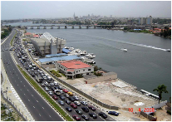

Lagos Urban Transport Project
Funded by the World Bank and the Lagos State Government
Designed to support the transport sector policy and strategy of the State Government
Established to improve efficiency of the public transport network in the State
LAMATA is the implementing
agency for the Lagos urban
Transport Project

Slide 5
Institutional Challenges/Issues
Multiplicity of agencies leading to
- Overlapping roles & Responsibilities – MoT
- Lack of clarity in Accountability/Reporting
- Confused Public/Stakeholders
- Inefficient allocation of resources
No coherent/ Integration of policy/Project
Authority/Ownership of
Declared Road Network
Informal Bus Operators
Amendment to LAMATA
law
Political Champion

Slide 6
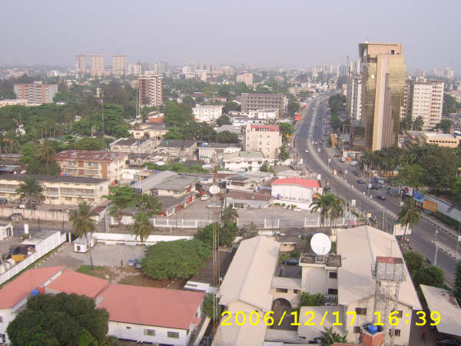
Institutional Challenges/Issues cont’d
MOT
- Policy
- Resource Mobilization
Monitoring& Evaluation
MVA/VIO
LASTMA – Traffic Management
LAMATA
- Planning &Integration
Implementation/
Execution
- Regulation

Slide 7
Physical Challenges
Infrastructure Maintenance Vs New Build
Co-ordination of projects/Project Implementation (with other agencies)
Construction in urban environment
Resettlement issues

Slide 8
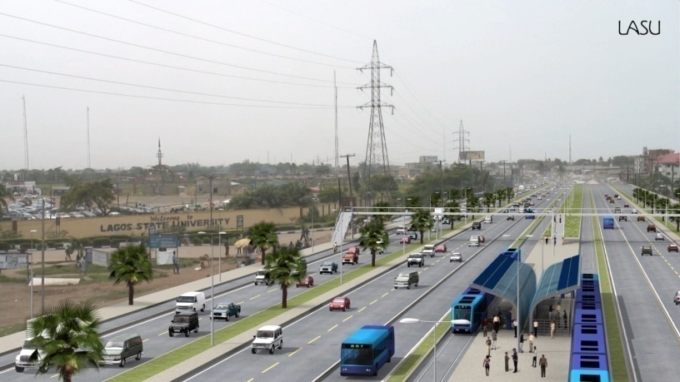
Organizational Challenges
Building professional capacity
Motivating Staff
Training
Funding
Fulfilling Mandate

Slide 9
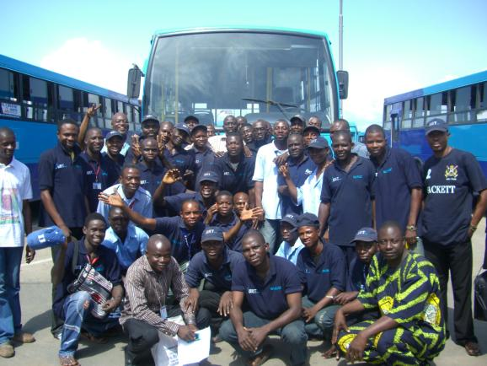
Communication Challenges
Introduction of new IEC concept
Complexity of the public
- Ethnicity
- Level of education
Communication Channels
Study Tours
Feed back/ Response
Mechanism

Slide 10
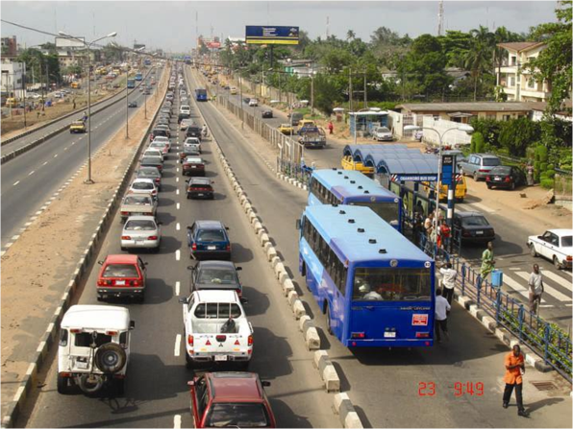
Learning points for other cities
Political Champion
Institution backed by legislation
Funding
Professional & Motivated staff
Stakeholder buy-in – Understanding the Vision
Early demonstration of effectiveness
/ Impact

Slide 11
THANK YOU

