Slide 1

SSATP Annual Meeting, Kampala, Uganda
18th – 21st October 2010
Good Strategies for Improved
Management & Financing of Roads in SSA
Mike Pinard
SSATP/World Bank Consultant
Notes:
The Minister of Comms and Transport in Zambia in her presentation yesterday on Transforming Transport in Support of Regional Growth and Integration set the scene for my presentation today on Road Reforms in Southern Africa and Prospects for Private Sector Participation.
Some of the key points in her presentation were:
Road transport plays a catalytic and facilitating role in support of the broader goals of economic growth and regional integration
Without a well developed road network there can be no meaningful development and economic growth in the SADC region.
A lot of countries still have poor road networks and resulting high road transport costs – 20% higher than those of developed regions of the world
Need for investment in the transport sector to rehabilitate, upgrade and modernise existing infrastructure, to bridge critical missing links
Worried about the lack of investments in road infrastructure
Need to forge new partnerships between gov’t and the priavtes sector
In my presentation today, I would like to share her with her and delegates to this forum, the far reaching reforms that have been and are being undertaken in the SADC region to dramatically improve prospects for private sector participation.

Slide 2
Objective of Presentation
To showcase examples of emerging good strategies that have led to improved management and financing of roads in SSA
  Based on a recent (2009) survey of commercialised road management practice in selected SSA countries
  Supplemented by findings from the Africa Infrastructure Country Diagnostic (AICD) project

Slide 3
Overview of Presentation
Introduction
  Background
  RMI Blue print
Impact of Reforms
  Lessons Learnt
Emerging Good Strategies
  Institutional
  Management
  Financial
  Operations
● The Way Forward
  CRM Model - Monitoring, Evaluation and Advocacy
  Next steps

Slide 4
Outline of Presentation
Background
  Based on a recent (2009) survey of commercialised road management practice in selected SSA countries
  Supplemented by findings from the Africa Infrastructure Country Diagnostic (AICD) project

Slide 5
Background
● Over the past 15 years, many SSA countries have embarked on wide-ranging policy reforms largely in line with the RMI blue print
Initial thrust of reforms was to create an independent source of funding for road maintenance based on road user charges
Second stage of reforms involved the creation of roads agencies, largely independent from line ministries, with responsibility for contracting out public works
Currently, there are 27 countries with a Road Fund, 19 with a Roads Authority and 13 with both a Road Fund and Road Authority

Slide 6
Rationale Behind the RMI Reforms
The primary objective of the reforms is commercialisation of the roads sector which requires complementary reforms in four areas – the four “Building Blocks” for sustainable management and financing.
Logic of the four “Building Blocks”
Block 1
Block 2
Block 3
Block 4
Clearly Defined Responsibilities
Stakeholder
Involvement
Adequate and Stable Funding
Sound Business Practices
Responsibility
Ownership
Financing
Management

Slide 7
Implementation and Impact of Reforms
The results of studies to review progress on the implementation and impact of the reforms may be summarised as – A Road Partially Travelled – as SSA countries are at different stages of implementation of the RMI principles.
In general, institutional reforms have had a discernible impact on outcomes:
  Countries with both Roads Funds and Road Authorities have generally been most successful at converting resources into road quality.
  Countries with traditional roads departments operating under a line ministry and relying on the government budgeting process for road maintenance funding have been least successful at converting resources into road quality.

Slide 8

Emerging Good Strategies - Institutional
Undertaking reforms as a “special project” to involve all stakeholders and achieve buy-in for change of status quo.
Publicity campaigns
Educational campaigns
Public relations measures

Slide 9
Emerging Good Strategies-Institutional Framework

Slide 10
Emerging Good Strategies - Institutional
Appointment of CEO:
  By advertisement and short-listing
  Interview and appointment by Board
  Performance-related contract with clear objectives, performance targets and annual appraisal
  Competitive salary
Appointment of staff
  Performance-based packages in line with private sector
  Targeted training in appropriate skills areas based on Training needs Analysis

Slide 11
Emerging Good Strategies - Institutional
Roads Boards
  Representing user interests but without vested interests (disqualification of persons who may introduce potential conflict of interest)
  Chairman appointed on recommendation of members
  Majority private sector representation nominated by general public and user organisations
  Necessary competencies spanning road management and financing, construction and maintenance, human resources, etc.
  Adherence to Code of Ethics
  Adequate remuneration

Slide 12
Emerging Good Strategies - Institutional
Adoption of inter-agency Procedures Agreement whereby RA submits to RF:
  Management and financial systems to be implemented by the RA, and measures to ensure:
    Compliance with rules and principles contemplated in RF Act;
    Efficient utilisation of funds allocated to RA i.r.o projects and programmes included in the Business Plan referred to in RF Act;
    Roads Authority submits to Road Fund a Procedures Agreement including
  Procedures to be followed by the RA in calling for, and evaluating and awarding tenders and in negotiation of agreements with any service for or on behalf of RA.

Slide 13
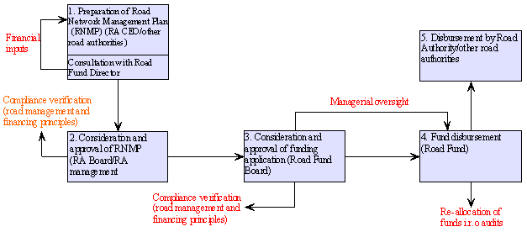
Emerging Good Strategies - Institutional
Procedures and controls for facilitating effective service delivery

Slide 14
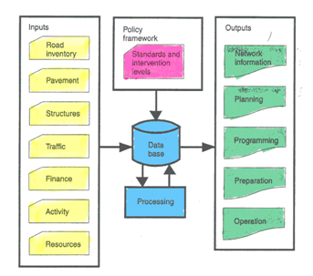
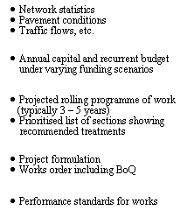
Emerging Good Strategies -Management
● Adoption of asset management approach:

Slide 15
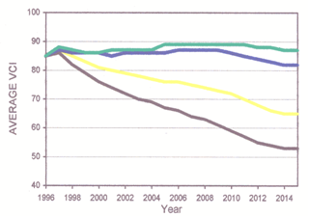
Emerging Good Strategies -Management
● Quantifying consequences of inadequate maintenance funding:
VCI = Visual Condition Index

Slide 16
Emerging Good Strategies–Financial Planning
Fund director prepares plan in consultation with RA CEO
Plan submitted to RF board for approval by Minister who tables before Parliament
Extracts from plan published for public notice

Slide 17
Emerging Good Strategies - Operations
Contracting out and procurement
  Move away from force account operations
  Clear separation of “client” from “service provider” functions and divesture of non-core functions to private sector service providers
  Adoption of multi-year, performance-based maintenance contracts
  Use of PPPs

Slide 18
Emerging Good Strategies - Operations
● RA undertakes technical auditing of projects in accordance with a guideline on how to carry out the audit and including the following activities:
  Check and physically verify that all executed works have been carried out in accordance with agreement and eligible for RF resources
  Verify that policy issues, performance and quality targets and submission of reports have been adequately addressed
  Review status of projects based on reports and performance agreements
  Determine whether audited projects have provided “value for money”.

Slide 19
Conclusion– Stakeholders’ Views
Need for more exchanges on country experiences: The Arusha and ASANRA workshops;
Need for additional advocacy across countries on reforms as tools to attain the goal of sustainable management and financing of roads – not goals in themselves.
More attention to the physical impact on the ground as a prerequisite to continuous user support and sustainability;
Need for monitoring, evaluation and advocacy tools

Slide 20
Way Ahead-Moving Beyond the RMI Focus
Revisit the RMI to:
  Step up monitoring, evaluation and advocacy
  Integrate lessons learnt
  Lay more emphasis on management efficiency and results effectiness

Slide 21
Thank you

