Slide 1
Corridor Logistics Initiatives
Jean Kizito Kabanguka

Slide 2
In this presentation….
Introduction
Logistics Costs vs Trade Competitiveness…
Landlocked Countries Vs Transit Corridors
Logistics Cost and Delays
Transport Observatories
Conclusions - Recommendations

Slide 3
Introduction
Few Definitions
Trade Transport Facilitation
Logistics Costs
Transport Costs
Transport Prices (Tariffs)
Transport Corridor
Types of Corridors
Transport Multimodal
Transport Intermodal
Trade liberalization

Slide 4
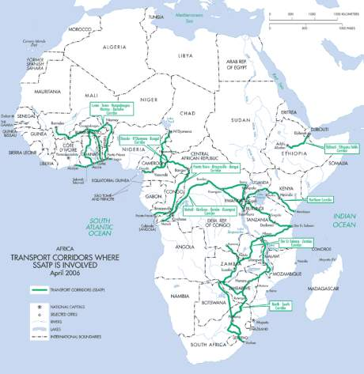
Transport Corridors in Africa

Slide 5
Logistics Costs Vs Trade Competitiveness
Globalization changes the environment within which manufacturing companies compete.
Ability to bring products continuously and effectively to the market: Management of logistics processes.
Logistics processes : Management of movement and storage of goods among the different members of the supply chain and across international borders.
Corridor Logistics costs: Sequence of transit operations with the following components

Slide 6
Landlocked Countries Vs Transport Corridors
Landlocked is based on the idea of dependence over the transit state,
Tyranny of distance : which implies high transaction costs
Mitigating measures for landlocked countries result of two set of actions:
    Developing a legal framework in treaties and regional agreements
    Developing regional transport infrastructure.
Transport prices in Africa remain the highest in the world
Transaction costs in general remain very heavy
Most regional transit agreements not Implemented
Notes:
Plus d’un pays sur trois est enclave en Afrique,
- 26% des terres africaines sont dans les pays enclaves,
- Plus de 200 millions d’habitants en Afrique vivent dans un pays enclave (ou 25% de la population en Afrique);
- 12 sur 15 pays enclaves en Afrique sont classifies vivant en dessous du seuil de pauvrete.

Slide 7
Landlocked Countries Vs Transport Corridors
Trade and Transport Facilitation Constraints
Border delays at main crossings
Infrastructure (intermodal interfaces, roads and rail condition, missing links, etc.);
Lack of enforcement of harmonized regulation
Delays incurred due to lengthy documentation and cargo clearance procedures
Lack of computerization or deficiencies in IT connections;
Transit time in ports
Modal Split and Trade Imbalance

Slide 8
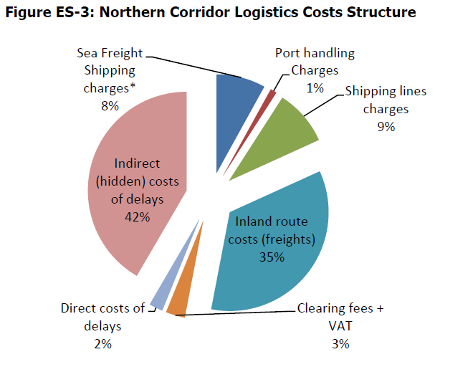
Logistics Cost and Delays

Slide 9
Logistics Cost and Delays
High Transport Cost
  Freight tariff USD per Ton/km
    USA 0.02 USD par T/Km,
    Kenya 0.04 per T/Km,
    Uganda 0.085 per T/Km,
    Rwanda 0.090 per T/Km
    Niger 0.13 per T/Km
    Congo DRC 0.12 per T/Km
    Burundi 0.11 per T/Km
    Burkina Faso 0.09 per T/Km
  Transaction Costs (Freight as % of value of imports)
    8% en Europe,
    11% en Afrique,
    30% Afrique de l’Est,
    35 % - 40% Rwanda, Burundi, Est de la RDC
Notes:
9

Slide 10
Logistics Cost and Delays

Slide 11
Logistics Cost and Delays
Delays along Selected Corridors (days)
 | Port | Trans | Port sec | Frontiere | Transport | Destin. Fin. | TOTAL
Douala Ndjamena | 24 | 8 | 8 |  |  | 3 | 39
Mombasa Kampala | 13 | 4 | 1 |  | 1 | 2 | 21
Dar ES Kampala | 17 | 5 | 2 |  | 1 | 2 | 27

Slide 12
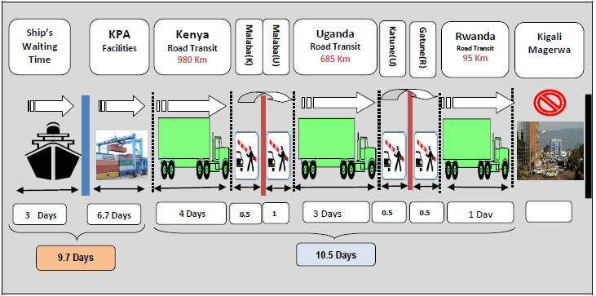
Logistics Cost and Delays

Slide 13
Logistics Cost and Delays

Slide 14
Logistics Cost and Delays
Uncertainties ( Ports – Mombasa)
14

Slide 15
Transport Observatories
SSATP DP 2 and Observatories
Past Experiences
  Northern Corridor
  UEMOA Corridors
Current Status
  CICOS Corridor
  Central and Dar Corridor
  Northern Corridor
  West Africa Corridors
Partnership
Framework
  Which indicators?
Data sources
  Existing computerized information
  Dedicated surveys where information is inadequate or missing

Slide 16
Transport Observatories

Slide 17
Transport Observatories
Observatories can supply many of the data requested,
Extend/compare facilitation measures across the continent to benchmark and look at best/good practices
The Corridor Performance Monitoring cannot be useful tools without
    Effective and Integrity Data Collection
    Critical analysis
    Wide distribution of the report generated
On regular basis, need to update the benchmark in order to cope with the Corridor Performance situation

Slide 18
Conclusion
Transit Transport Constraints it is not just the poor quality of physical infrastructure,
Non implementation of regional trade facilitation instrument is an issue
More regulatory reform and harmonization is required to drive down the cost of trade
As regions become more integrated, regulation should pass on to regional regulatory bodies
Appropriate mechanisms for stakeholder involvement Effective transit agreements
Increasing regional integration and trade is vital to the competitiveness of Africa in the global market

Slide 19
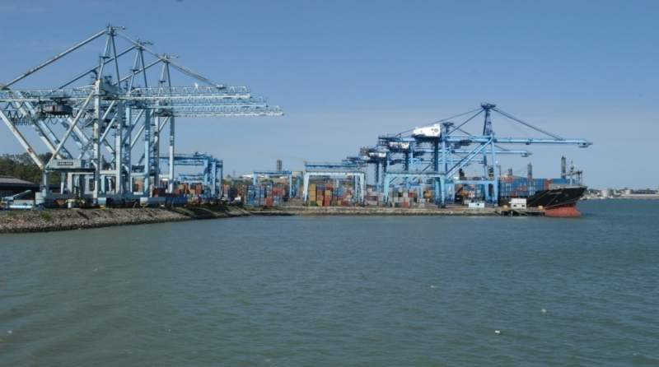
Thank You
www.worldbank.org/afr/ssatp
www.ssatp.org

