Slide 1

Innovative Use of ICT in Transport Data Management and the Management of Transit Corridors
Transport Observatories
Single Window
Supporting East African Integration
Integrated Border Management
Transit Management
Security
ICT Activities Supported by TradeMark East Africa
SSATP Annual General Meeting 2010 – Kampala, Uganda.
18th – 21st October 2010

Slide 2

In this Presentation
About TMEA
Importance of ICT
Advances in ICT in the EAC Region
ICT Activities Supported by TMEA
Single Window / Integrated Border Management
Transit Management
Transport Observatory Projects
Conclusion

Slide 3
First… About TMEA
Multi-Donor-Funded, Not-for-Profit (donors include the governments of the UK, Belgium, Netherlands, Denmark, Sweden and Canada).
HQ in Nairobi with offices in all EAC Member states and a presence at the EAC Secretariat. Sister organization to TMSA, Support to the EAC-COMESA-SADC Tripartite.
Aims to promote regional trade and economic integration in East Africa through five key pillars:
  Support to the EAC Secretariat
  Support to the Ministries of the EAC in the member states
  Support to Private Sector organizations towards integration activities
  Support to the creation of an EAC Monitoring and Evaluation framework
  Support in Trade and Transport Facilitation
Provides support through both regional programmes and national programmes.

Slide 4
Why is ICT Important?
“Advance Information”, “Faster Processing”, “Information Sharing”
In some EAC landlocked countries, up to 45% of the cost of goods is attributable to transport costs.
One component of the transportation costs is attributable to NTBs, the costs of which are eventually passed to the consumer of the goods.
There are physical NTBs (e.g. a police road-block) and “non-physical” NTBs e.g. delays in documentation, processing times for customs release, waiting for lab results etc.
Reduction in the NTBs has a direct impact on the reduction of the transport costs. Reduction on transport costs should have a direct impact on the cost of goods/cost of doing business.
ICT is an enabler in this regard. ICT systems, as has been proven in many instances, can be used to reduce NTBs.

Slide 5

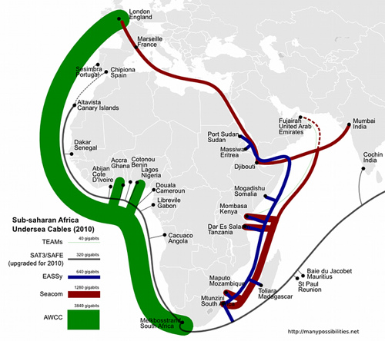
ICT Advances in the EAC
Region
Broadband internet at our doorsteps at unbelievable prices connecting us to the rest of the World.
GSM Mobile network coverage throughout the EAC region.
Major software companies based in our cities as regional hubs (Microsoft, Google, HP).
Remote borders with major traffic connected/networked.
ICT is no longer a line-item on the Miscellaneous Budget

Slide 6
As a Result…
Modernization at the Ports:
  KWATOS – Manifests, Terminal Operations, Billing
  PCBS / National Single Window Initiatives
  Modernization at Revenue Authorities:
  ASYCUDA++ / Simba 2005, Risk Management (red, green, yellow lanes)
  Networking of remote border stations
  Information sharing with other agencies / Single Windows / IBM
  RADDEx, EAC Customs Interconnectivity Project
  Modernization for Transit Traffic Management:
  Electronic Cargo Tracking Systems
  Regional Transit Guarantee Schemes
  Weigh-in-Motion at weighbridges
  Modernization of Monitoring and Evaluation:
  Transport Observatories by the SSATP and partners

Slide 7
TMEA Interventions
Many further opportunities and much better and faster ways of doing what has already been achieved:
  Better use of technology.
  Take advantage of cheaper technology.
  Innovative new approaches to solve the “old” problems much more efficiently.
TMEA focusing its support to partner in ICT Activities (under the TMEA Transport Facilitation objective) on:
  Single Window
  Integrated Border Management
  Transport Observatories
  Transit Management
  Focus on adding value to what has already been achieved.

Slide 8

Single Window / IBM
What?
  SW: Single point to submit trading documents
  IBM: Coordination of agencies at border stations
  Expanded View on SW:
  Single point of information dissemination
  Single point for applications/issuance of documents by agency
  Single point for submission of trading documents by trader
  Single point of feedback on submissions
  Expanded View on IBM:
  Coordination via information sharing of agencies:
  Agency HQ to border offices
  Agency to agency nationally
  Agency to counterpart agency regionally

Slide 9
Single Window / IBM
Guiding Principles for TMEA:
  No duplicating areas covered under the various National Single Window activities, but to identify support gaps and participate there as value addition.
  Provide support to agencies not adequately covered under the current National Single Window initiatives.
Innovative ICT Solutions in this area?
  KSC, e-regulations portal, handbooks, seminar on int’l trade, database of service providers
  FEAFFA, e-regulations portal, handbooks, e-learning platform, database of service providers
  KTA, e-regulations portal, transporters and trucks database
  Phyto Agencies in EAC: e-certification, advance cargo information, analysis and results system
  Bureau of Standards in EAC: e-certification, advance cargo information, analysis and results system

Slide 10
Transit Management
TMEA is working with some revenue authorities and banks to develop a proof of concept on handling of duties and the issue of transit bonds:
  Duties + taxes collected at the port of entry (for imports) or at the point of start of journey (for exports).
  On non-compliance enroute, revenue authority of that country is able to access the funds as penalties and fines.
  On completion of transit successfully, amount is accessed by the relevant revenue authority as duties and taxes paid.
  Needs a real-time tracking system to monitor movement of goods.
  Features:
  No bonds, but same security afforded to revenue authorities. Can work next to national or regional bonds if needed.
  Less administration on the part of trader/revenue authority.
  Less money held in bond (by some estimates an excess of $1Bn is held as bonds in force on any given day in COMESA).
  No incentive for Trader to “dump”, duties + taxes are already paid.

Slide 11
Transit Management
Technology to make this work already exists:
  Banks have e-banking systems capable of handling money transactions.
  Existing banking legislation will adequately cover the operation.
  No major re-configuration of Customs systems needed… no major rework of transit operations needed (all that is needed is a new “bond” category in the transit module).
  Cargo tracking systems are in place. E.g. Data from RADDEx could support this in the interim for provision of entry/exit/discharge & release data.
Progress so far with regards to pilot:
  TMEA has developed prototype of MIS system needed at the bank.
  Major bank has just signed on to pilot.
  Revenue Authorities on both Northern and Central Corridor approached and are keen to pilot.
  Private sector (KSC and FEAFFA) keen to participate as well.
  Preparations for a study to detail the Ecomonic Impact of the introduction of such a scheme is being finalized to start off in November 2010.
  Pilot-run ready to start Nov/Dec 2010, Central Corridor first.

Slide 12
Transport Observatories
What?
  Centralized, corridor-based database to monitor corridor performance
  Uses automated data and road surveys as primary data sources for analysis
  Quantifies causes of delays and where they happen on the corridor
Why?
  Identification of areas for improvement in relation to targets (or benchmarks);
  Provide a set of tools for diagnosing Corridor problems/bottlenecks
  Measure effectiveness of programs designed to address Corridor problems
  Providing key reliable information to policy makers in the region to facilitate formulation of policies for better transit and trade

Slide 13
Transport Observatories
  Northern Corridor (NCTTCA):
  Baseline Survey (2003)
  Design of Observatory and Testing (2005-2006)
  Pilot and Enhancement (2007-2008)
  Web-based Database Prototype and Testing (2008-2009)
  Central Corridor (TTFA):
  Baseline Survey (2010)
  All the above funded by SSATP except for 2008-2009 run on Northern Corridor which was funded internally by the NCTTCA
  Current partnership with SSATP, TradeMark East Africa, TTCANC (on Northern Corridor) and eventually with TTFA (on Central Corridor)

Slide 14
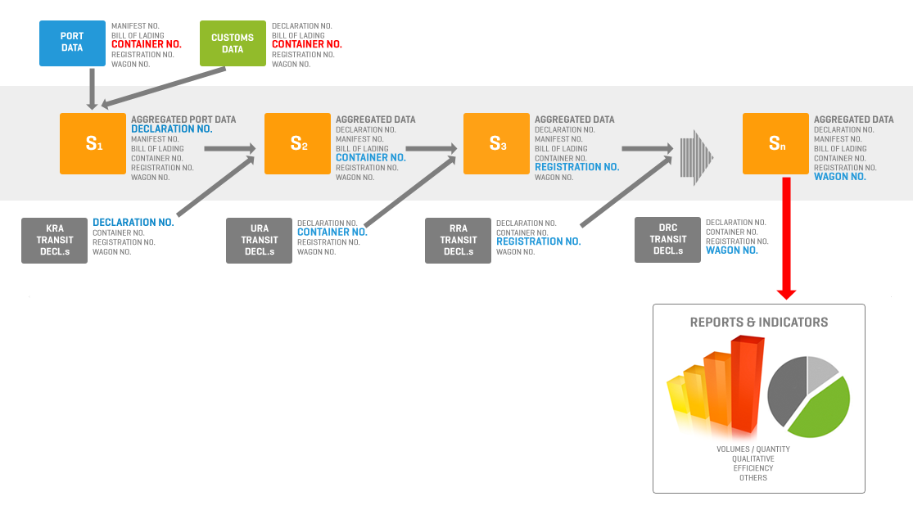
Transport Observatories

Slide 15
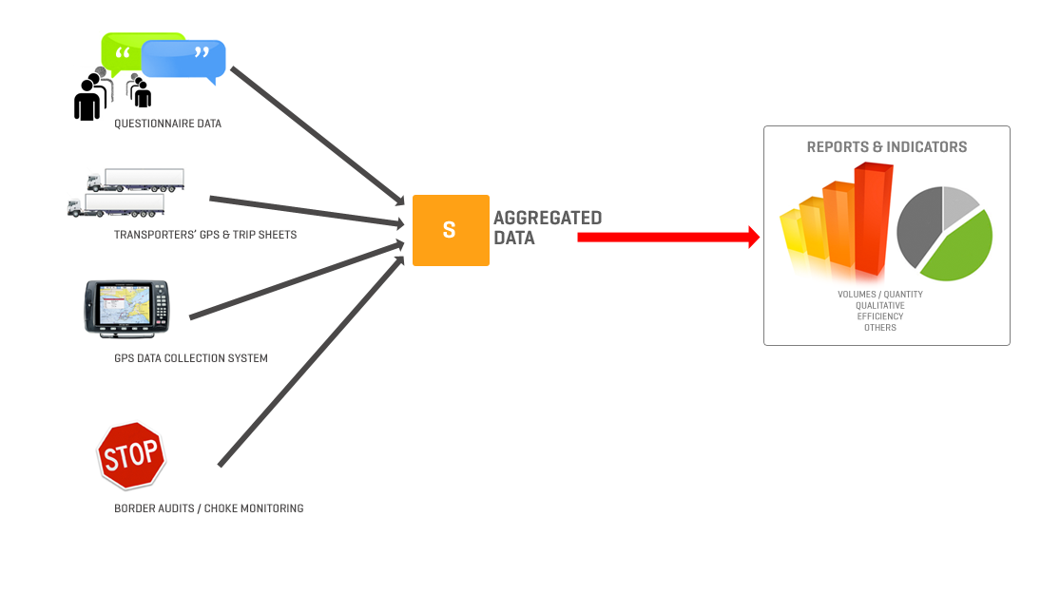
Transport Observatories

Slide 16
Transport Observatories
  New Innovative ICT approaches:
    Develop full-fledged web-based platform with ad-hoc reporting platform.
    Develop methodology and use to perform Road Surveys Sustainably
    Develop and implement automated data collection methods sustainably
    Develop dissemination methods (handbooks, reports, e-newsletter)
    Pilot GPS-based method to collect road-based data in collaboration with the Kenya Transporters Association
    Undertake border audits (process and delay monitoring)
  Partner with SSATP and NCTTCA to implement above on the Northern Corridor.
  Work closely with SSATP to create a similar partnership with TTFA on observatory activities on the central corridor and to develop a model for observatories that can be replicated.

Slide 17
In Conclusion
Technology advances have created opportunities for the elimination of some non-tariff barriers.
Focus on ICT support should also be directed to the smaller agencies who have so far not benefited from previous support.
TMEA is focusing its support towards adding value to already ongoing ICT activities in the region and encourages the adoption and efficient use of current technology to facilitate trade.
It can be done… ICT is no longer “rocket science”. So let’s do it ☺

