Slide 1


Road Network Evaluation Tools:
Overview, Main Concepts, Applications
Administração Nacional de Estradas (ANE)
Cesar Queiroz, Ph.D.
Consultant, former World Bank Highways Adviser
Maputo, Mozambique, 4-8 November 2013

Slide 2
RONET Overview, Main Concepts, Background and Applications
Infrastructure and economic development
Optimization defined
A common concern: how to optimize maintenance and rehabilitation
What is required for an agency to use RONET?
RONET structure
RONET applications
Next steps

Slide 3
Infrastructure
“The built environment in which we live” (Ausubel and Herman)
The physical framework upon which the economy operates and our standard of living depends (ASCE)

Slide 4
Infrastructure comprises
Public utilities: power, telecommunications, piped water supply, sanitation and sewerage, solid waste collection and disposal, piped gas
Public works: roads, dams, canals, railways, ports, waterways, airports, buildings

Slide 5
Developing and Developed Countries
Developing countries include low- and middle-income economies
Developed (advanced, industrial, rich) countries denote high-income economies
The World Bank’s main criterion for classifying economies is gross national income (GNI) per capita, previously referred to as gross national product (GNP)
http://data.worldbank.org/indicator/NY.GNP.PCAP.CD

Slide 6
Classification of Economies
Economies GNI per capita
Low-income $1,035 or less
Middle-Income $1,036 to $12,615
Lower $1,036 to $4,085
Upper $4,086 to $12,615
High-income $12,616 or more
Source: http://data.worldbank.org/about/country-classifications

Slide 7
Examples of Gross National Income
GNI,
$/cap

Slide 8
Examples of Gross National Income (cont’d)
GNI,
$/cap

Slide 9
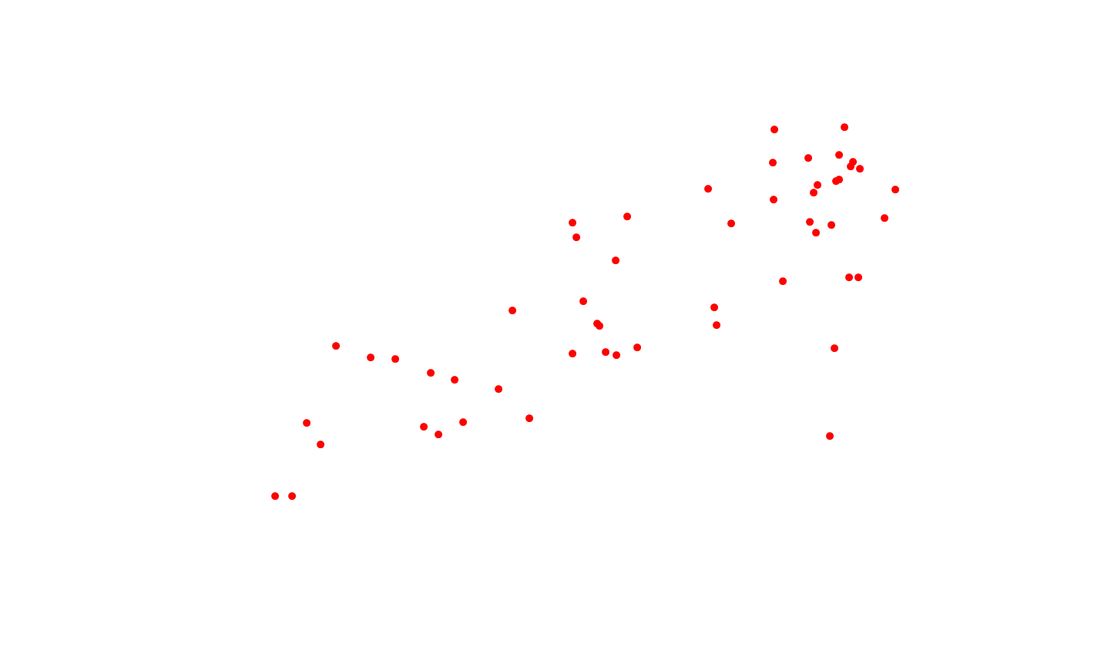
Economic Development and Infrastructure
GNI ($/pop)
GNI = 1.39 PRD
R squared: 0.76
98 countries
Source: Queiroz and Gautam

Slide 10
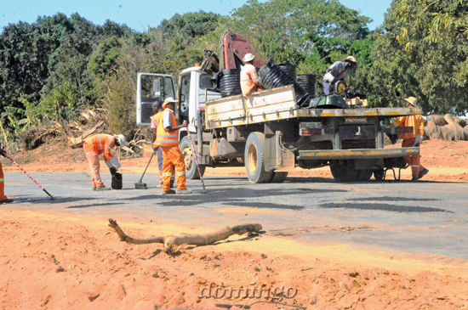
Abrir estradas para fazer chegar o desenvolvimento
Source: Domingo, Maputo, 3 November 2013

Slide 11
Optimal Road Condition
Total Road Transport Costs
Budget, Costs $
Road Agency
Budget
Too
Large
Optimal
User Costs
Too
Small
Too Poor
Optimal
Too Good
Road Condition

Slide 12
Road Network Evaluation Tools
RONET, developed by Rodrigo Archondo-Callao for SSATP, helps decision makers to:
  Monitor network condition
  Plan allocation of resources, including optimizing road network maintenance and rehabilitation
  Assess consequences of macro policies
  Design Road Asset Management Systems

Slide 13
Road Network Evaluation Tools
Availability: RONET is available free of charge on the World Bank website at: http://go.worldbank.org/HWVR0FWEF0
http://go.worldbank.org/FF0CT8M770
General use: RONET can be used in any city, country or region, for paved and unpaved road networks, provided that appropriate data are available
Version 2.00 – latest version, published in 2009

Slide 14
RONET Version 2.00

Slide 15
What is Required for an Agency to Take Advantage of Tools Such as
HDM-4 and RONET?
Updated road inventory and condition data, e.g., length of roads in each category, pavement structure, road roughness
Traffic data, e.g., volumes by vehicle category, weight of heavy vehicles
Road user cost data, e.g., price of new vehicles, fuel consumption and cost
Unit cost of road works, e.g., rehabilitation ($/km), new construction ($/km)

Slide 16
Road Network Length Matrix
Total 5 X 5 X 5 X 5 = 625 Road Classes

Slide 17
International Roughness Index (IRI)
Main road condition indicator used by models such as RONET and HDM
A standard scale used throughout the world to quantify the roughness of roads
The IRI summarizes the roughness qualities that impact vehicle response (such as vehicle vibration)
It relates to overall vehicle ride, operating cost, dynamic wheel loads, and overall surface condition

Slide 18
Development of IRI
The International Road Roughness Experiment, Brasilia, Brazil, 1982
Reference: World Bank Technical Paper No. 45, “The International Road Roughness Experiment: Establishing Correlation and a Calibration Standard for Measurements,” available at: http://go.worldbank.org/0UUNR93490

Slide 19
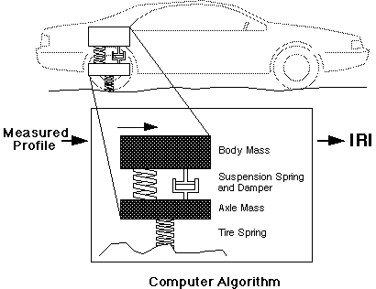
International Roughness Index
Notes:
One solution is to pass the profile through the IRI filter before the comparison is made. Instead of just getting an index, you get a filtered profile that is weighted to emphasize what counts to the IRI.

Slide 20
IRI Meaning and Uses
IRI is determined by measuring the profile along the wheel paths of the road, and then filtering the profiles through a quarter-car mathematical model to simulate the suspension deflection of a passenger car
Its uses include assessing road condition and as a construction specification

Slide 21
IRI Calculation from Road Profiles
“ProVAL” - Profile Viewing and AnaLysis - an engineering software used to view and analyze pavement profiles, including IRI calculations
Sponsored by the US Federal Highway Administration (FHWA)
Available free of charge from: http://www.roadprofile.com/

Slide 22
IRI Calculation from Road Profiles
“RoadRuf” – a tool for computing IRI, available from the University of Michigan at: http://www.umtri.umich.edu/divisionPage.php?pageID=62
RoadRuf includes an interactive X-Y plotter and a spectrum analyzer
A sample program for calculating IRI is available at: http://www.umtri.umich.edu/content/IRIMain.f

Slide 23
RONET Paved Road Deterioration Model
RONET uses simplified incremental road deterioration model for paved roads:
  traffic loading (YE4)
  pavement modified structural number and
  subgrade bearing capacity (SNC)
  pavement age (t)
  environmental coefficient (m)
  existing condition (IRI_{a})

Slide 24
Road User Costs Model
Expressed as a polynomial function of roughness for each vehicle category
Developed using World Bank RUCKS (Road User Costs Knowledge System) model
URUC - unit road users’ cost ($/vehicle-km)
IRI - pavement longitudinal roughness (m/km)
a₀, a₁, a₂, a₃ - model coefficients that depend on input data (e.g., new vehicle, fuel and tire costs)

Slide 25
Example of IRI and Road Condition
Very good: IRI less than 2.5 m/km
Good: IRI from 2.5 m/km to 3.5 m/km
Fair: IRI from 3.5 m/km to 5.5 m/km
Poor: IRI from 5.5 m/km to 10.5 m/km
Very poor: IRI higher than 10.5 m/km

Slide 26
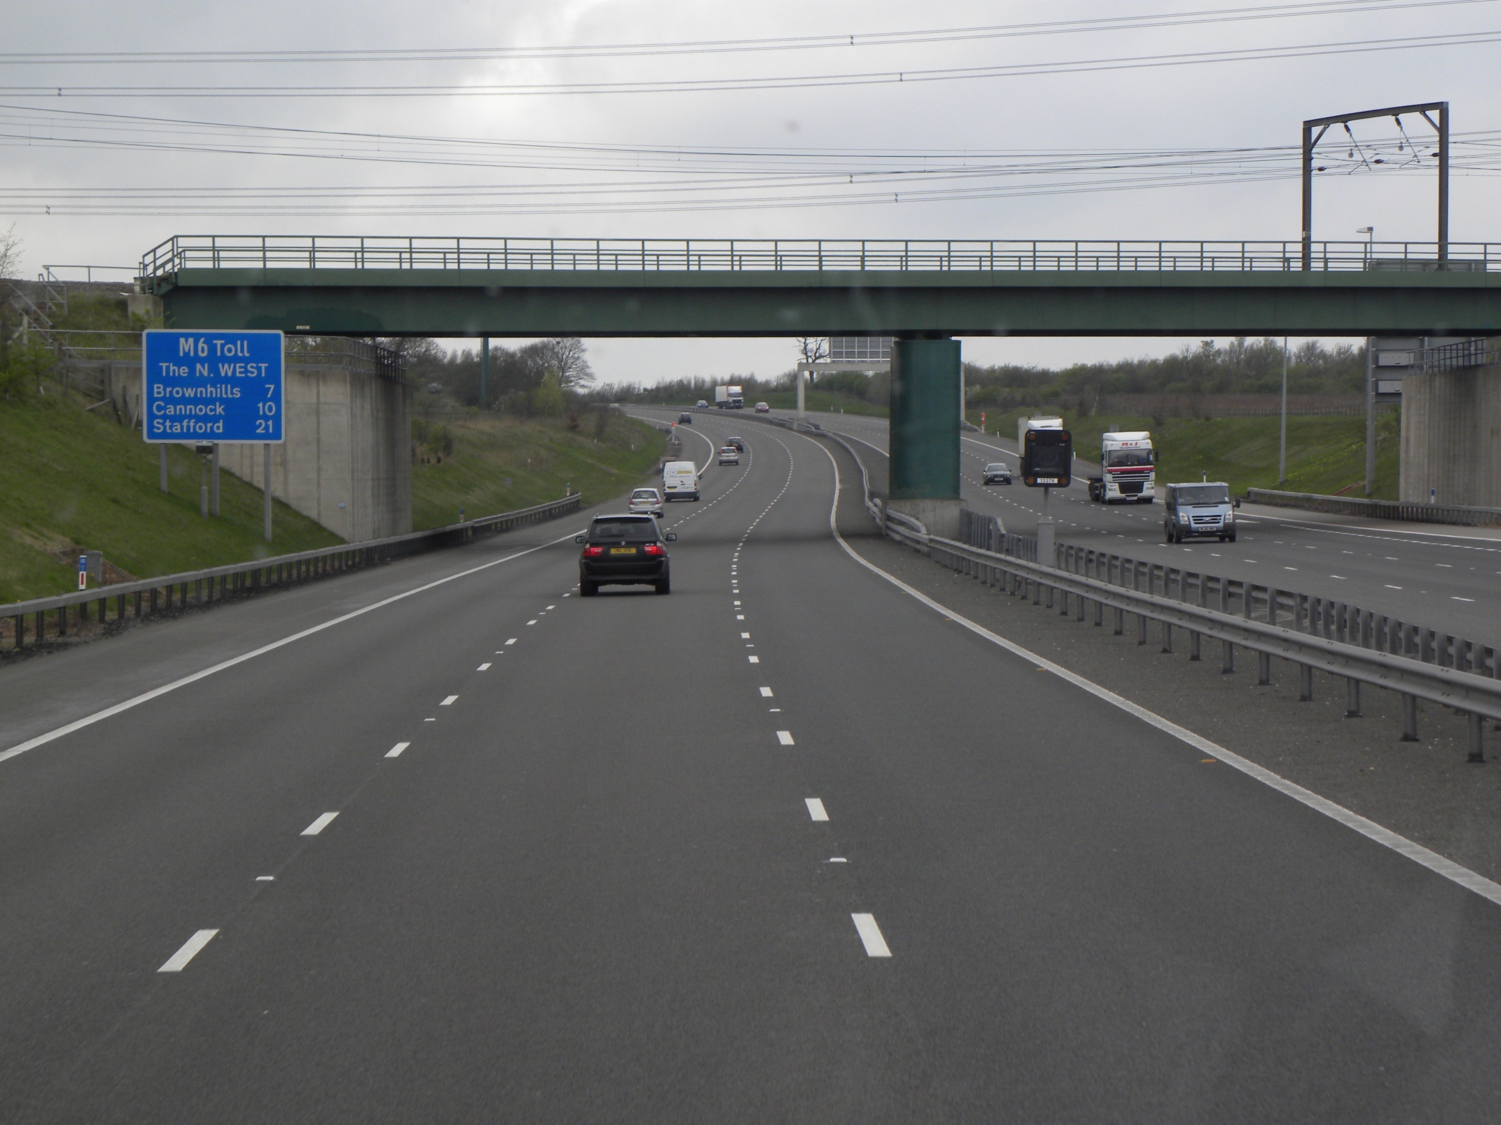
Riverside Freeway, SR 91, CA

Slide 27
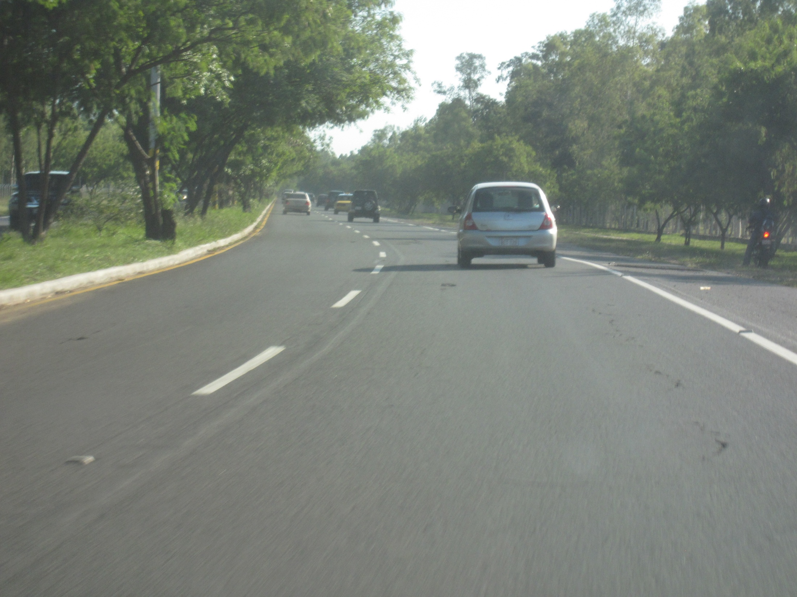

Slide 28
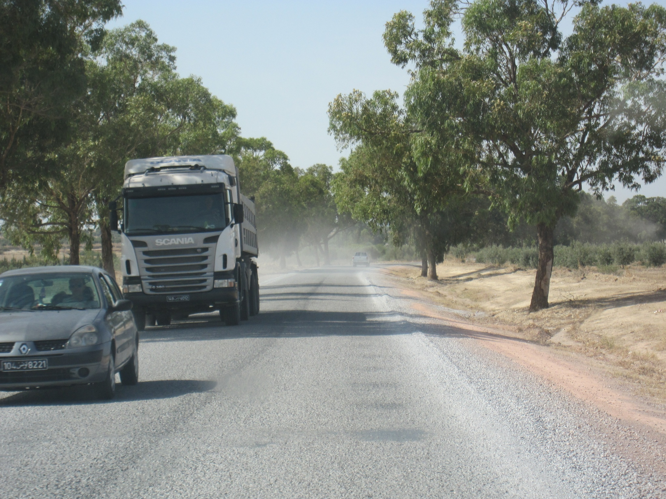

Slide 29
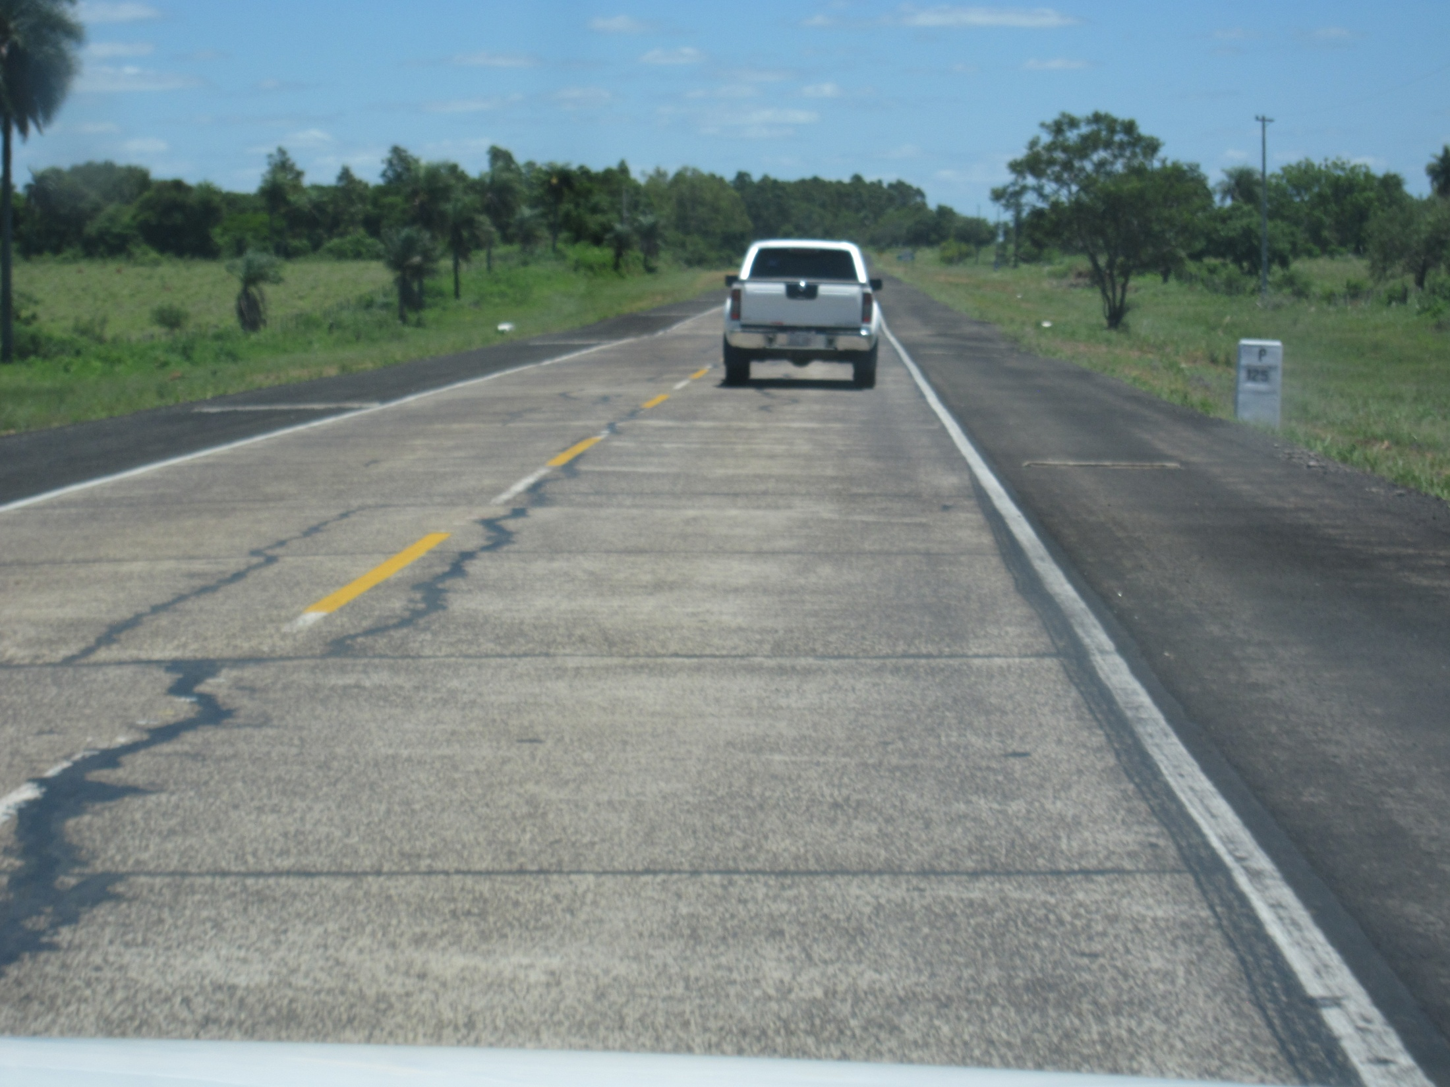

Slide 30
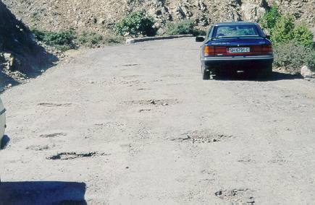

Slide 31
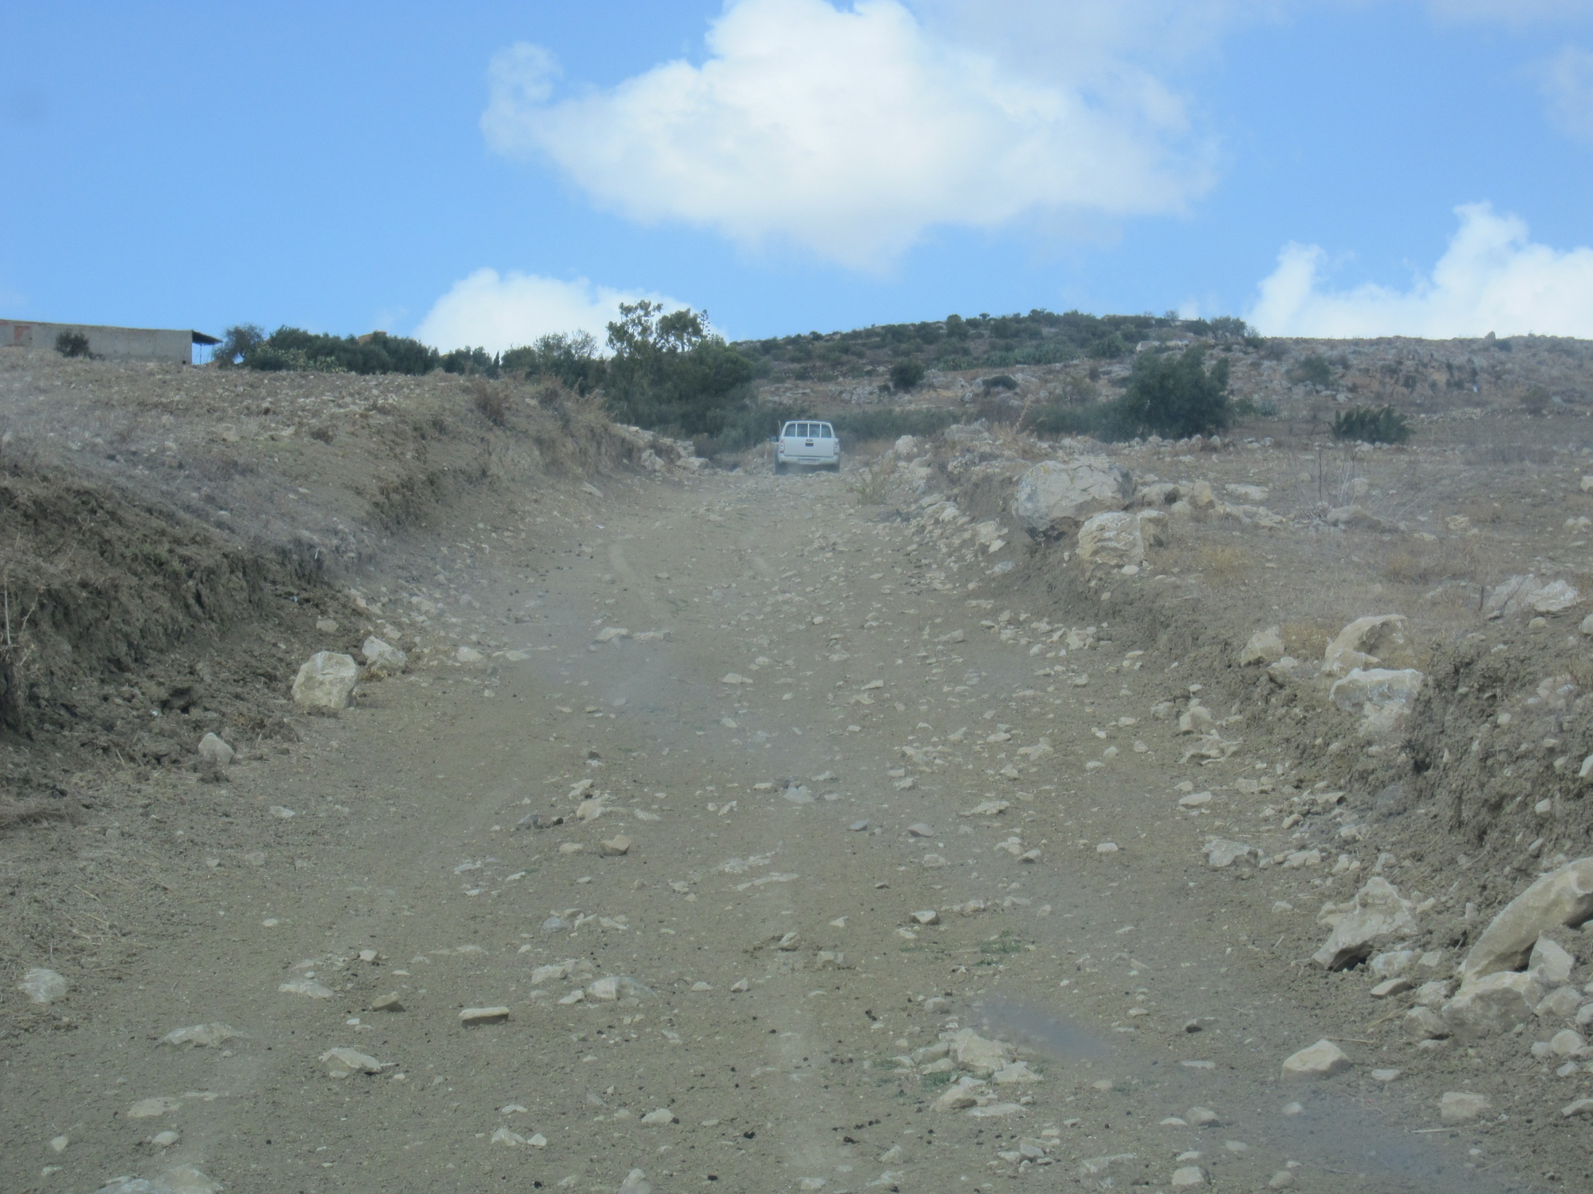

Slide 32
Types of Road Network
Five or less network types can be defined by the user based on functional classification, region, terrain type, or environmental type

Slide 33
Surface Types
RONET uses five surface types. The country specific characteristics of the surface types are user defined

Slide 34
Traffic categories vary by surface type

Slide 35
Road Condition Categories
Very Good: requires only routine maintenance (RM)
Good: requires RM plus preventive maintenance or spot regravelling or repairs
Fair: requires RM plus periodic maintenance
Poor: requires RM plus strengthening or partial reconstruction
Very Poor: requires RM plus full reconstruction

Slide 36
RONET Main Input Data
Length of road sections (per category, traffic, condition) comprising the network
Unit cost of road works
Selected country data (e.g., discount rate, fuel cost, salaries, vehicle fleet, traffic growth rate)

Slide 37
Current Asset Value Calculation

Slide 38
Performance Assessment
What are the consequences of different budget scenarios?

Slide 39
RONET evaluates alternative maintenance and rehabilitation road works standards for each road class
Road Work Standards
Code | Standard
A | Very high
B | High
C | Medium
D | Low
E | Very low
F | Do minimum
G | Do nothing
Defined in RONET at: Capital Road Works Standards Configuration

Slide 40
Asphalt Mix Roads Standards

Slide 41
Optimal Standard
RONET determines optimal standard per road class
Least Total Society
Costs

Slide 42
Budget Scenarios
Optimal + 2 | Two standards above optimal standard per road class
Optimal + 1 | One standard above optimal standard per road class
Optimal | Optimal standard per road class
Optimal – 1 | One standard below optimal standard per road class
Optimal – 2 | Two standards below optimal standard per road class
Optimal – 3 | Three standards below optimal standard per road class
Do Minimum | Do minimum on all road classes
Do Nothing | Do nothing on all road classes
Custom | User defined standard per network type and traffic category

Slide 43
An Example of Consequences to the Road Agency

Slide 44
Consequences to Road Users

Slide 45
Consequences to Society

Slide 46
Consequences to Road Network Condition: Roughness (IRI in m/km)

Slide 47
Road
Works
Details
(M$)
Other Tables for:
($/km-year)
($/veh-km)
(km/year)
per surface class
and surface type

Slide 48
Road User Charges

Slide 49
Next steps
Review RONET’s User Guide
RONET familiarization interactive exercise
Obtain as realistic as possible information on a road network of each participating country
Develop an optimum road network M&R program for the selected network
Prepare a brief report and present the results

Slide 50
Cesar Queiroz
SSATP/World Bank Consultant
Former World Bank Highways Adviser
Tel +1 301 755 7591 queiroz.cesar@gmail.com
Washington, DC, USA

Slide 51
RONET Team Exercise
Road Network Two-lane Equivalent:
Length, condition and traffic levels
This example of calculation is for primary roads. Please follow the example and obtain the lengths per cell for secondary and tertiary roads.

Slide 52
Cesar Queiroz, former World Bank Highways Adviser, is an international consultant on roads and transport infrastructure. His main expertise is in public-private partnerships, road management and development, performance-based contracts, port reform and rehabilitation, improving governance, quality assurance and evaluation, research, teaching and training. Between 1986 and 2006, he held several positions with the World Bank, including Lead Highway Engineer and Principal Highway Engineer. Prior to joining the World Bank, Cesar was the deputy director of the Brazilian Road Research Institute in Rio de Janeiro. He holds a Ph.D. in civil engineering from the University of Texas at Austin, a M.Sc. in production engineering from the Federal University of Rio de Janeiro, and a B.Sc. in civil engineering from the Federal University of Juiz de Fora, Brazil. Cesar has published two books and more than 130 papers and articles. His recent assignments include infrastructure advisory services to Russia, Brazil, Latvia, Lithuania, Poland, Ukraine, Philippines, Uganda, Sri Lanka, India, Egypt, Colombia, Laos, Mozambique, Saudi Arabia, Tunisia, Sweden and Norway. He is currently a visiting professor at the University of Belgrade, Serbia, and has lectured on PPP at George Washington University since 1996, and at the International Law Institute since 2007.

