Slide 1

Road Safety Management
Martin Small
Road Safety Workshop
Dakar, 5 December 2013

Slide 2
Globally, road traffic injury is a major health issue
WHO estimated 1.24 million fatalities occurred on the world’s roads in 2010
Road traffic injury in 2010 was estimated by the Global Burden of Disease study to be:
  The no.1 cause of death worldwide for 15-24 year olds
  The no.2 cause of death worldwide for 25-39 year olds, behind HIV/AIDS
  The cause of twice as much death as malaria
WHO projections are for road traffic injury to accelerate, and overtake HIV/AIDS as a cause of death by 2030

Slide 3
In Africa, we are witnessing a road safety crisis
Annual Deaths
Sub Saharan Africa

Slide 4
The African road safety crisis is set to escalate at the same time as some control is exerted over Millenium Health Goals
 |  | 2015 | 2030 | % change
Road Traffic | Deaths | 242,530 | 513, 632 | +111.8%
 | Deaths/100,000 people | 25.1 | 38.0 | +51.4%
Malaria | Deaths | 401,708 | 426,530 | +6.2%
 | Deaths/100,000 people | 41.6 | 31.6 | -24%
HIV/AIDS | Deaths | 1,147,589 | 1,317,788 | +14.8%
 | Deaths/100,000 people | 118.9 | 97.5 | -18%
WHO 2013 Projections
for Sub Saharan Africa

Slide 5
Effectively responding to the escalation in road traffic injury in Africa will require
The prevention of road traffic death and disability to be formally recognised as an international Post 2015 development priority, like Malaria and HIV/AIDS
Lead road safety agencies to be established if they do not already exist, or strengthened, in order to effectively lead sustained safety improvements in African states
Investment in regional trade road corridors which breaks the link between development and death, through systematic mainstreaming of road safety
Other key management and investment decisions; a stronger road safety voice for Africa; knowledge transfer, data systems; and driver and vehicle regulation

Slide 6
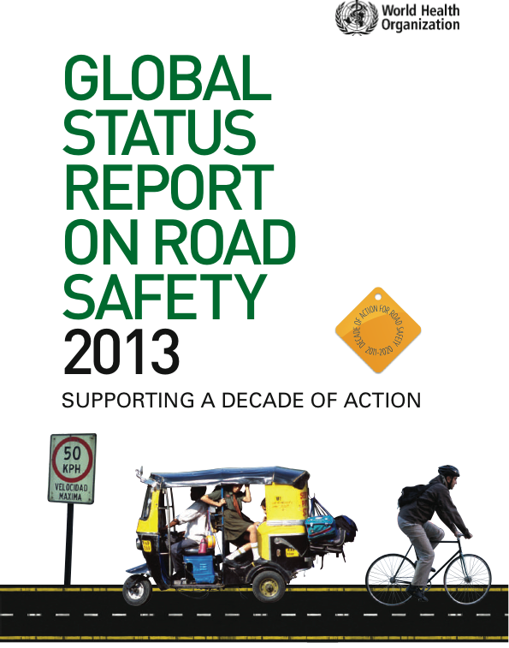

Slide 7
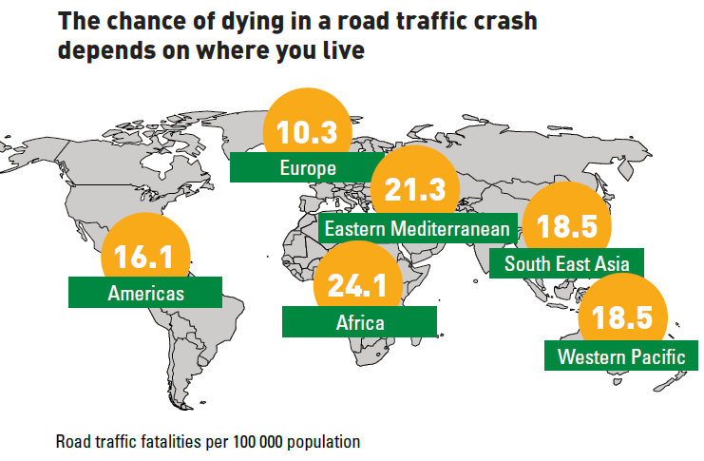
Notes:
least motorized of the six world regions, suffers the highest rates of road traffic fatalities
regional average is 24.1 deaths per 100 000 population,
Africa has highest road traffic death rates per 100 000 population

Slide 8
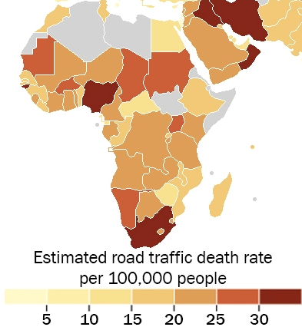
Notes:
37 of 44 surveyed countries having death rates well above the global average of 18.0 deaths per 100 000 population
19 countries in the middle-income category, covering 44% of the Region’s population, the rate is 27.8 deaths per 100 000 population. By comparison, the global average for middle-income countries is 20.1 deaths per 100 000 population.

Slide 9
Global Status Report on Road Safety 2013 (Senegal)
Note: Senegal data collected by multisectoral consensus meeting and cleared by Ministry of Health and Preventive Medicine

Slide 10
Global Status Report on Road Safety 2013 (Senegal)

Slide 11
Moving road safety management forward in Senegal

Slide 12
2004 foundation report
Key recommendations include:
Establish Lead Agency to drive road safety results and coordinate multi-sectoral response
Pilot substantial evidence based projects to demonstrate good practice and promote further investment

Slide 13
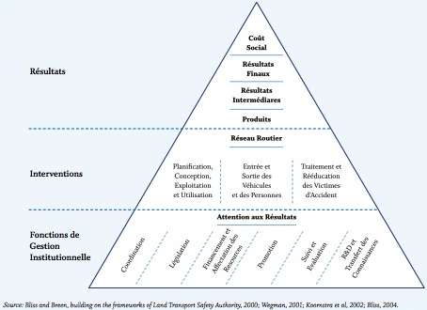
The road safety management system
Road safety is produced.
Institutional management functions produce interventions, which in turn produce results.

Slide 14
The Lead Agency focuses attention on seven management functions …
Results focus
Coordination
Legislation
Funding and resource allocation
Promotion
Monitoring and evaluation
Research & Development, and knowledge transfer

Slide 15
These seven management functions are essential to developing effective interventions
Interventions address
  Design, operation and use of the road network
  Entry and exit of vehicles and road users to the network
  Recovery of road crash victims from the network, and their rehabilitation
Interventions set standards and rules for these activities, and implement measures to achieve compliance with them (using education, enforcement and incentives)

Slide 16
… with the overall purpose being directed to achievement of three types of results
Final outcomes consist of social costs, fatalities and injuries
Intermediate outcomes consist of reduced speeds, higher safety belt and helmet wearing rates, improved road and vehicle safety ratings, etc.
Outputs consist of deliverables such as hours of police patrol, volume of infringement notices, length of road treated, etc.

Slide 17
The “Safe System” approach to road safety
Aims to develop a road transport system better able to accommodate human error, commonly achieved through better management of crash energy, so that no individual road user is exposed to crash forces likely to result in death or serious injury.
Incorporates many strategies for better management of crash forces, with a key strategy being road network improvement in conjunction with posted speed limits set in response to the level of protection offered by the road infrastructure.
Relies on strong economic analyses to understand the scale of the trauma problem, and direct investment into those programs and locations where the greatest potential benefit to society exists.
OECD/ITF Towards Zero: Ambitious Road Safety Targets and the Safe System Approach

Slide 18
The “Safe System” approach (continued)
Is underpinned by comprehensive management and communication structures incorporating all key government agencies and other organisations which have a role in determining the safe functioning of the transport system.
Aligns safety management decision making with broader economic goals and human and environmental health goals, and a commercial environment that generates demand for providers of safe road transport products and services.
Embraces the ethos of “shared responsibility” for road safety among the various actors of the road transport system, such that there is a shared vision amongst citizens, public, private and not for profit organisations regarding the ultimate safety ambition, and how to achieve it.
OECD/ITF Towards Zero: Ambitious Road Safety Targets and the Safe System Approach

Slide 19
Important new guidelines
A systematic and logical process for directly addressing priority road safety needs on regional corridors in a streamlined and iterative manner – relevant not only within Africa, but also to other developing regions of the world.

Slide 20
Very often the improvements implemented under most trade and transport corridor projects in developing countries are compromised by increases in road traffic crash risks and casualties.
Dr Etienne Krug, World Health Organisation

Slide 21
Targeting Regional Trade Road Corridors for Road Safety Investments
Road safety investments in RTRCs present the best opportunities for intervention and achieving road safety results. Typically, about 50% of deaths take place on just 10% of the road network
These corridors are characterized by high traffic volumes and speeds and often an unmanaged mix of motorized traffic, and non-motorized users
By targeting these corridors, national and regional entities have an opportunity to make rapid progress in strengthening road safety management capacity and to quickly improve results

Slide 22
We are witnessing a road safety crisis throughout Sub Saharan Africa
Where lead road safety agencies do not exist, they need to be established, and where they are established, they need to be strengthened
A road safety management capacity review would support a critical assessment of country needs
Early use of SSATP guidelines in safe road trade corridors will get results and build capacity

Slide 23
Merci

